Slide 1

CEIS 110
Introduction to programming
Shawne Gambrill

Slide 2
Introduction and Class Overview
In this class I learned the basic commands and processes to create code using Python.
The work depicted in this presentation was performed using Anaconda Spyder IDE and Microsoft Excel.
This presentation shows the results of Weekly Projects I completed during this class.

Slide 3
Module 2 Project
In week 2 of this course, I created a flowchart for the class project using Visio. I then installed the NOAA-SDK library.
The Project was completed using Visio and Anaconda Spyder IDE
The project focused on 2 objectives:
  Develop a flow chart for the overall project using Visio
  Download and install NOAA-SDK library using Spyder

Slide 4
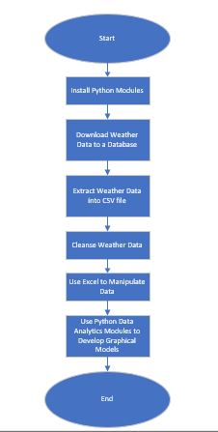
Module 2 Project – Creating a flowchart
Create a flowchart with the following processes:
Install python
Download weather data to a database.
Extract weather data from database into a comma separated file with python
Cleanse weather data
Use Excel to manipulate data
Use python data analytics modules to develop graphical models

Slide 5
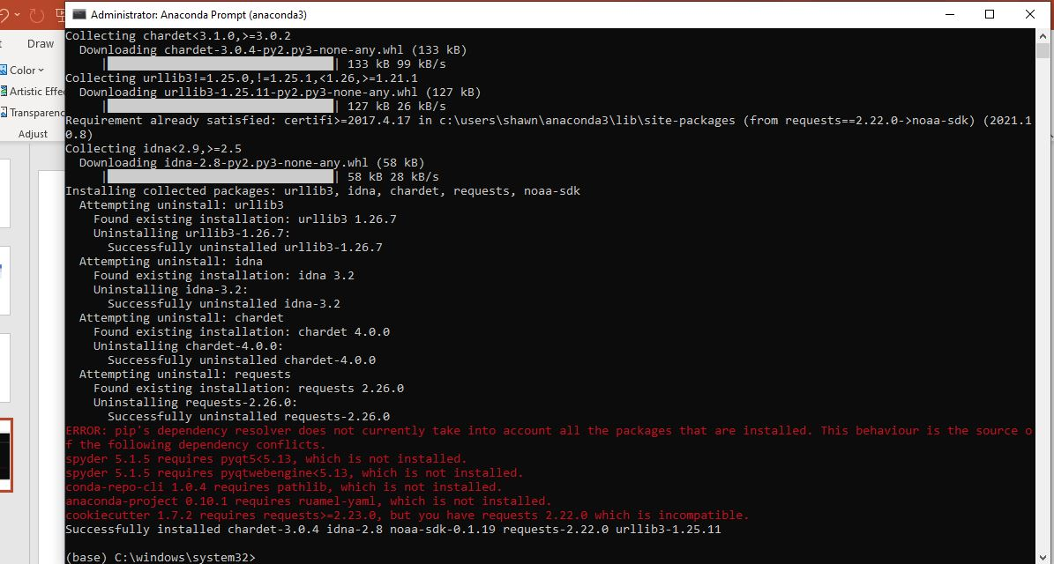
Module 2 Project – Install Noaa-sdk library
Install NOAA-SDK library using the command:
  pip install noaa-sdk

Slide 6
Module 3 Project
In week 3 of this course, I used Spyder to download weather data for my zip code.
The Project was completed using Anaconda Spyder IDE
The project focused on 4 objectives:
  Practice writing and executing Python programs using Spyder
  Use download data from the cloud using an API
  Create a relational database
  Save data into a database table using SQL and Python

Slide 7
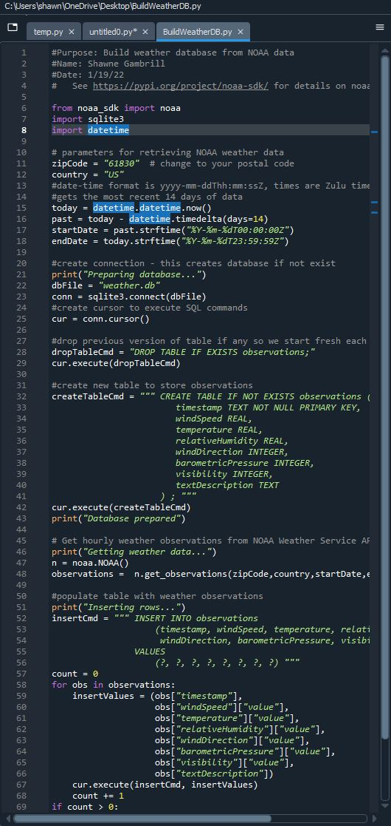
Module 3 Project – Building a weather database file
Creating a Build WeatherDB.py program:
  Copy code into Python
  Change name and zip code
  Run Program to download the database

Slide 8
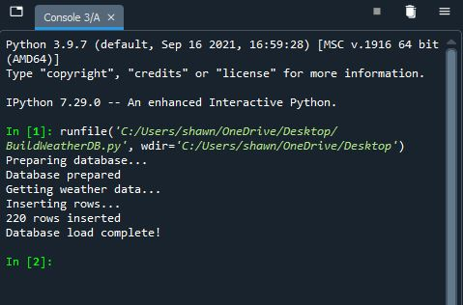
Module 3 Project – Verifying Data has downloaded
Verify database has downloaded:
  Verify that the database has loaded completely without errors
  Verify that there are enough rows inserted to build a good database

Slide 9
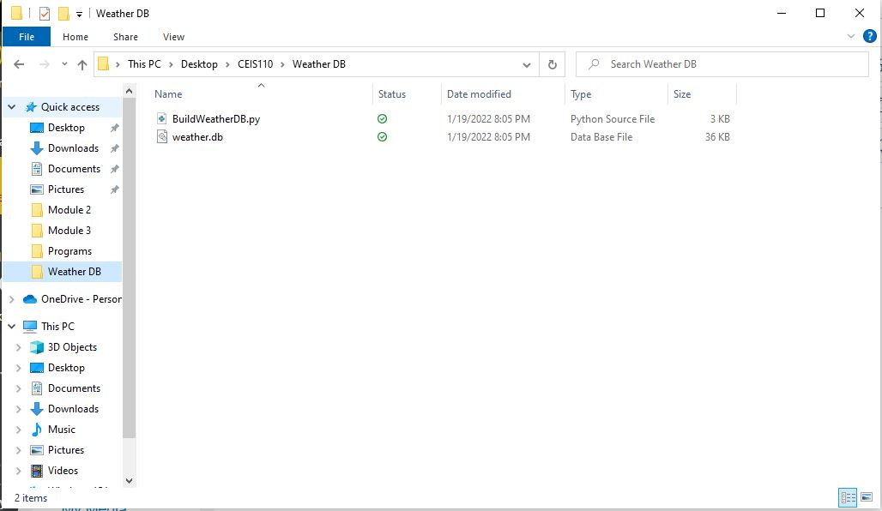
Module 3 Project – Verify that weather.db file was created
Verify that database file was created
  Use Windows Explorer to check the designated folder
  Verify that the newly created database file exists

Slide 10
Module 4 Project
In week 4 of this course, I queried the database using SQL.
The Project was completed using Anaconda Spyder IDE
The project focused on 2 objectives:
  Connect to a database using Python
  Execute a simple SQL SELECT query

Slide 11
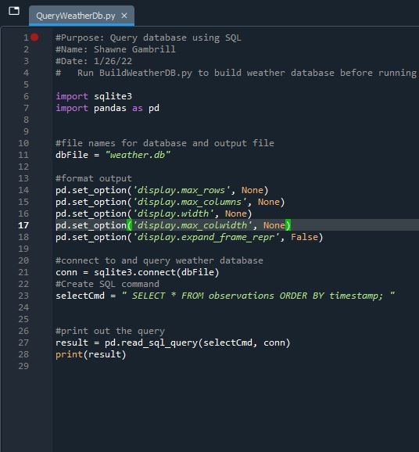
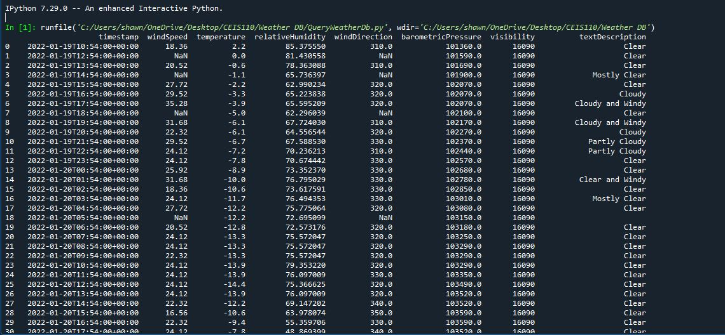
Module 4 Project – Query to retrieve all columns and rows
Create a new Python file as QueryWeatherDB.py
  Copy code into Python and run the program
  View the data in the Console

Slide 12
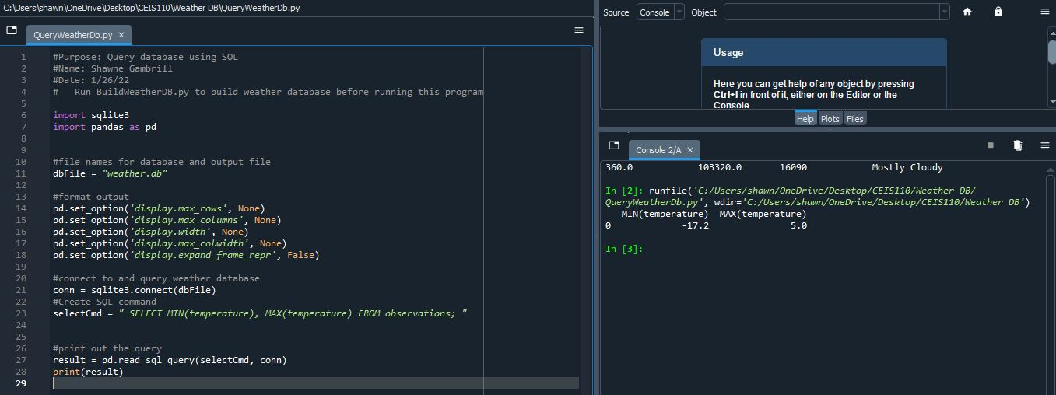
Module 4 Project – Query to retrieve lowest and highest temperatures
Change the selectCmd line to:
  selectCMD=“SELECT MIN(temperature), MAX(temperature) FROM observations;”
Verify the data that is shown in the console

Slide 13
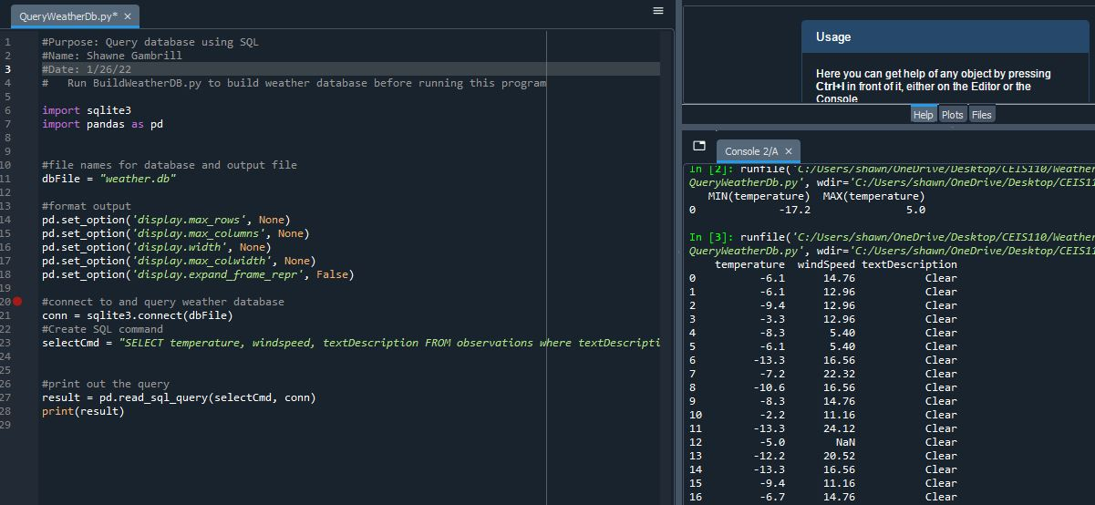
Module 4 Project – Query to retrieve all clear days
Change the selectCMD line to:
  selectCMD=“SELECT temperature, windspeed, textDescription FROM observations where textDescription = ‘Clear’;”
  Verify data in the console

Slide 14
Module 5 Project
In week 5 of this course, I learned about Querying and Manipulating Data with SQL and Python.
The Project was completed using Anaconda Spyder IDE and Microsoft Excel
The project focused on 4 objectives:
  Retrieve data from a database with an embedded SQL query in Python
  Cleanse data and manipulate data from a database in Python
  Save data as a CSV file
  Open data in Excel and create a chart

Slide 15
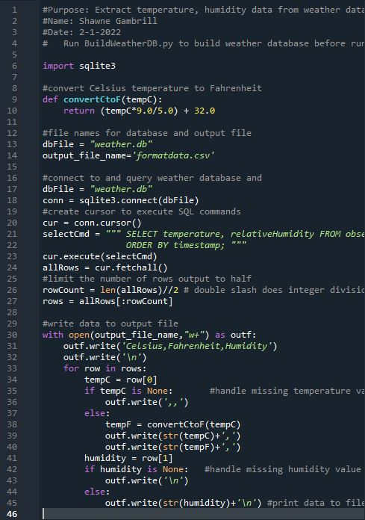
Module 5 Project – Creating a program to retrieve Data
Create an ExtractTempHumidity.py program:
  Create program to retrieve just temperature and humidity

Slide 16
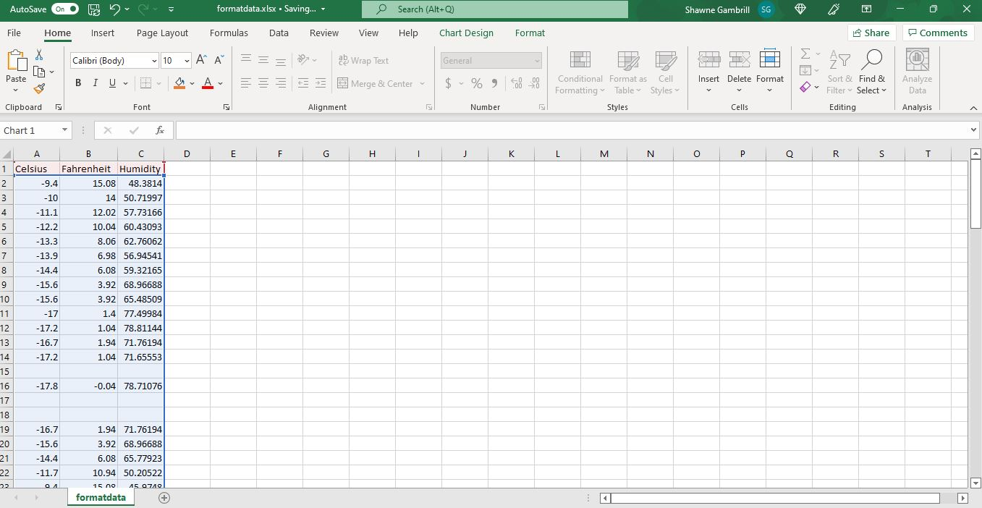
Module 5 Project – Retrieve and Convert data to csv
Retrieve data from the CSV file that was created by Python:
  Open the formatdata.csv file that was created
  Save the file as an .xlsx file type
  Open the newly created Excel Workbook file

Slide 17
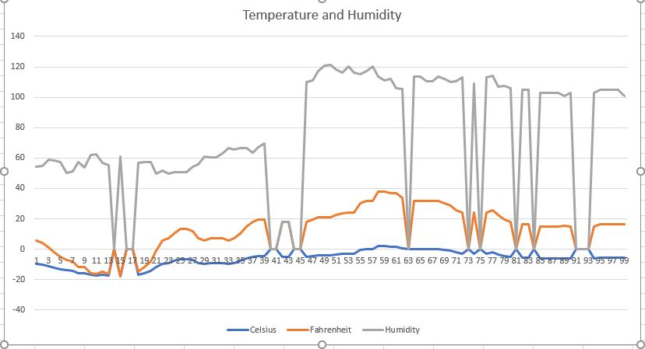
Module 5 Project – Create a chart with the data
Create a Temperature and Humidity Chart:
  Select all data in the workbook
  Create a line chart
  Change title to Temperature and Humidity

Slide 18
Module 6 Project
In week 6 of this course, I developed Graphical Models and Interpreted the Results.
The Project was completed using Anaconda Spyder IDE
The project focused on 3 objectives:
  Use Python data analytics modules
  Compare data at different times
  Use data analytics to interpret and analyze data from a database

Slide 19
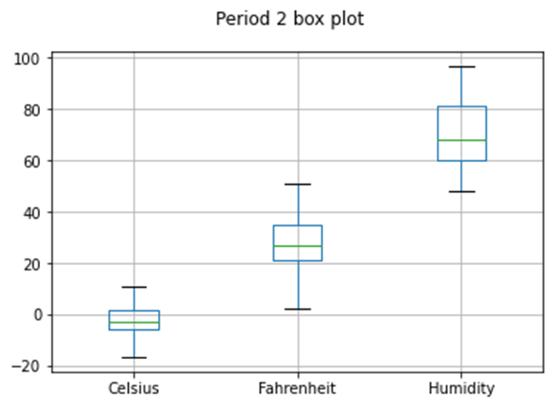
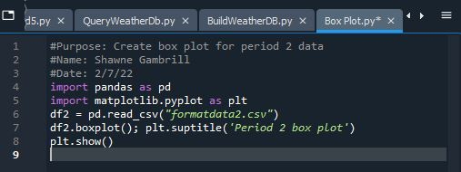
Module 6 Project – Create a Box Plot
Create a Box Plot in Python
  Import pandas
  Import matplotlib.pyplot
  Write code to create a box plot of temperatures for period 2 data

Slide 20
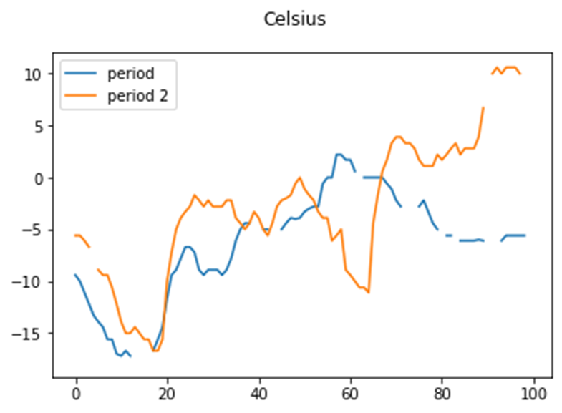
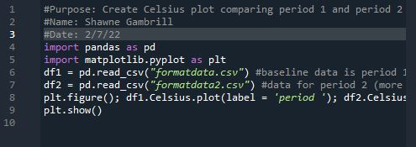
Module 6 Project – Create a Line chart
Create a Line Chart comparing Temperatures over 2 periods
  Import pandas
  Import matplotlib.pyplot
  Write code to create line chart

Slide 21
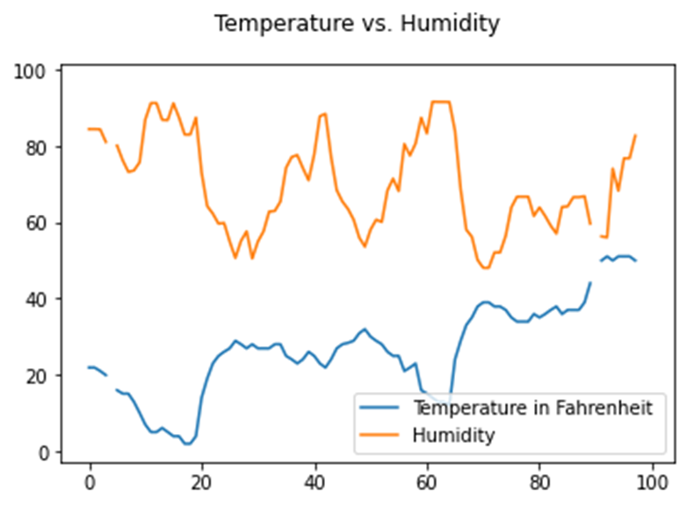
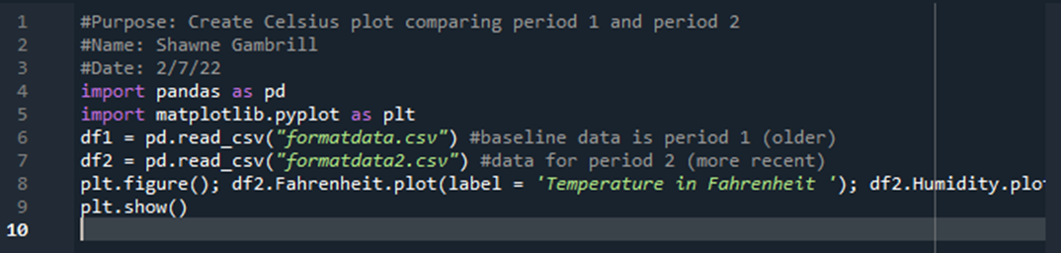
Module 6 Project – ANALYZE Data using charts
Answer the question: Is humidity increasing or decreasing as the temperature rises?
Analysis: Based on the data plotted in my chart, when the temperature was below 40 degrees the humidity was adversely affected by the temperature. The colder it was, the higher the humidity was. As the temperature reached 40 degrees, the humidity showed a rise as the temperature rose.

Slide 22
Module 6 Project – Prediction based on analysis
Develop a prediction based on the data. What variations in temperature and humidity do you expect over the next few hours or days? How would humidity change if temperature goes up or down?
  Based on the plot of this chart, the temperature will increase, and the humidity will increase along with it. If the temperature drops below 40 degrees, the humidity will begin increasing as the temperature decreases.

Slide 23
Weekly Project Challenges
I found this course challenging due to my lack of prior experience with Python programming. For me, the biggest challenge was learning the syntax and what commands to use. Through this course, as well as the Zybooks Labs, I have gained some comfort with Python and enjoy manipulating code to get different results.

Slide 24
Skills learned
I have learned commands to write basic programs using Python.
I have interacted with Anaconda Spyder, Visual Studio, and Microsoft Visio.

Slide 25

Thank You
CEIS110 Final Project
Shawne Gambrill

