Slide 1

CEIS 106
Introduction to operating systems- Linux+
Shawne Gambrill

Slide 2
Introduction and Class Overview
In this class I learned the basic commands and processes to work with a Linux based Operating System.
The work depicted in this presentation was performed on a Virtual Machine within the Microsoft Azure cloud environment.
This presentation shows the results of Weekly Projects I completed during this class.

Slide 3
Module 2 Project
In week 2 of this course, I learned how to work within the Linux Filesystem Hierarchy by exploring the Linux Filesystem tree and basic commands.
The Project was completed using a Microsoft Azure cloud-based Ubuntu VM
The project focused on 4 objectives:
  Navigating the Linux filesystem tree
  Creating Directories and Files
  Copying and Removing Directories and Files
  Locating Directories and Files

Slide 4
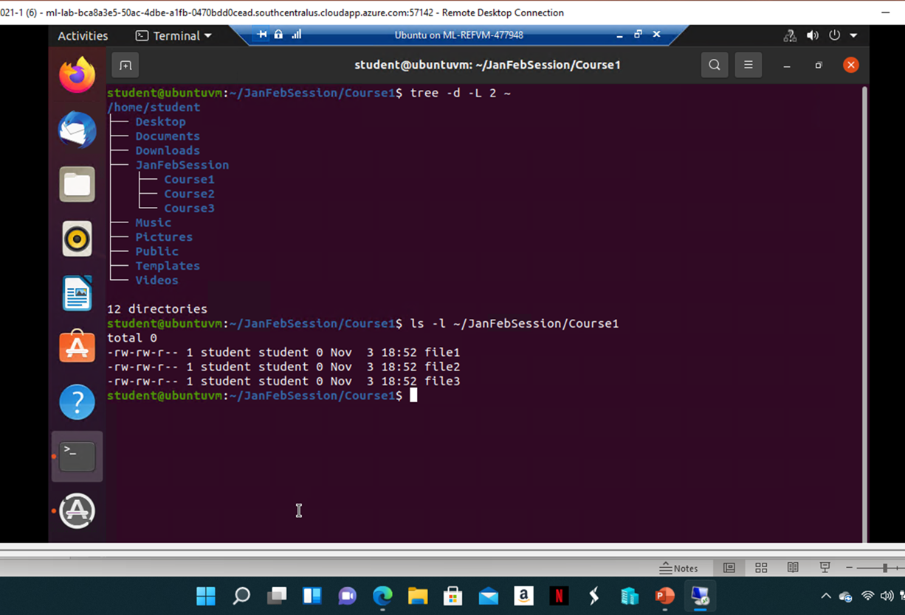
Module 2 Project – Navigating and Creating
Commands learned and used in Objective 1 and 2:
  I used the “cd ~”, “pwd”, and “tree” commands to navigate directories.
  I created directories and subdirectories using the “mkdir” command.
  I created files within the directory using the “touch” command.
  I used the “tree” and “ls –l” commands to list the newly created files within the subdirectory (pictured Left).

Slide 5
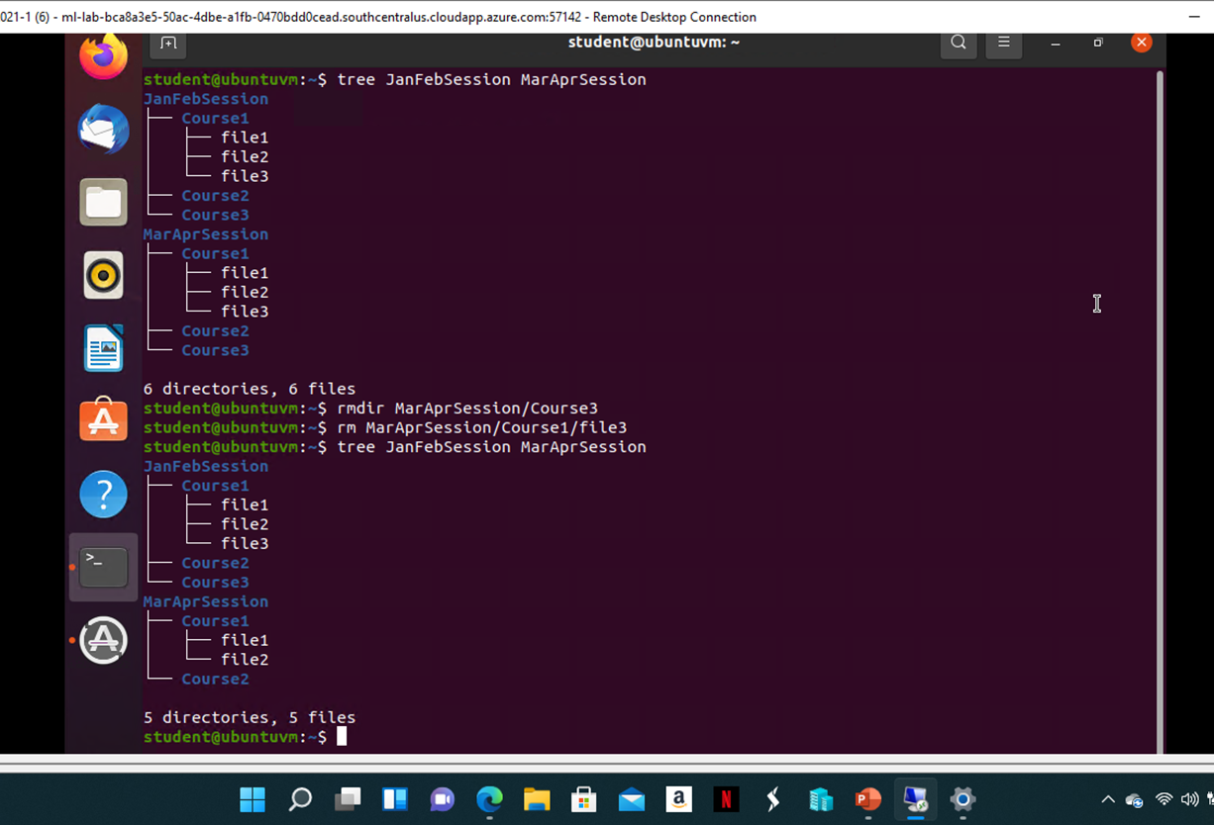
Module 2 Project – Copying and removing
Commands learned and used in Objective 3,
  I used the “cp –r” command to create a copy of the subdirectory I had created.
  I used the “rmdir” command to remove a subdirectory and the “rm” command to remove a file from another subdirectory.
  I ran the “tree” command to verify my changes (pictured Right).

Slide 6
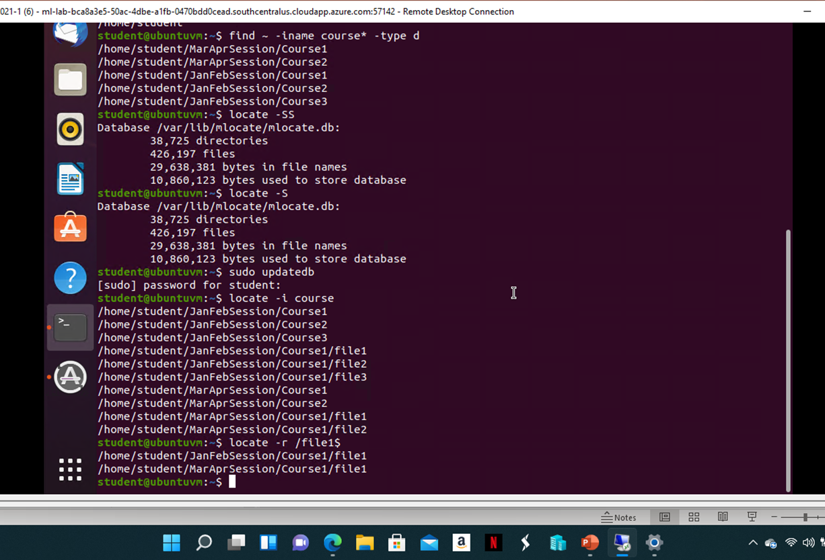
Module 2 Project –Locating
Commands learned and used in Objective 4:
  By using “find ~ -iname course* -type d” I was able to see a list of directories that started with “course”.
  I used “find ~ iname file*” to find files that contain the string ”file”.
  I used “locate –S” to review the local database and “sudo updatedb” to update the local database.
  I was then able to use the “locate –i course” to find directories and files that contain the string “course”.
  Finally, I used “locate –r /file1$” to list all files with the “file1” string (pictured Right).

Slide 7
Module 3 Project
In week 3 of this course, I learned how to create shell scripts within Linux.
The Project was completed using a Microsoft Azure cloud-based Ubuntu VM
The project focused on 4 objectives:
  Creating Shell Scripts
  Changing Script file permissions
  Setting the PATH variable
  Making the PATH variable permanent

Slide 8
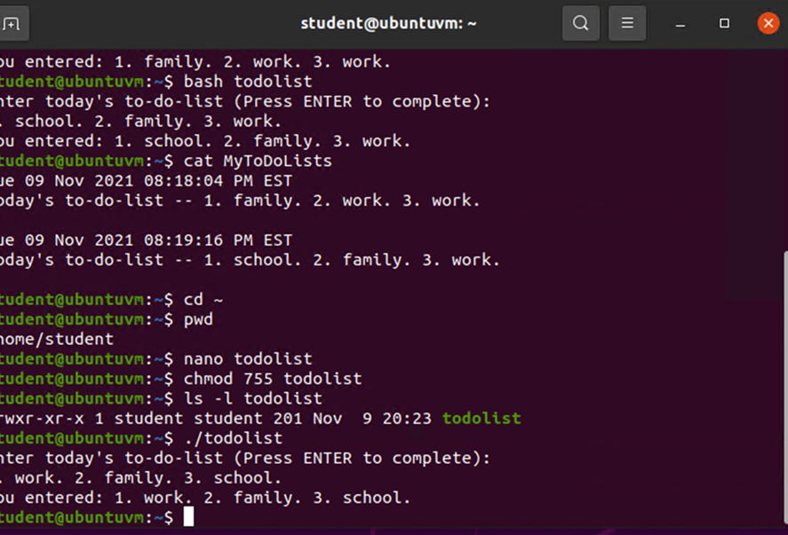
Module 3 Project – Creating shell scripts and permissions
Commands learned and used in Objective 1 and 2:
  I used “nano” to create a shell script for a basic To Do List
  I executed the script using “bash”.
  I used “cat” to verify info that was entered while running the script.
  I then used “nano” to modify the hashpling and “chmod” to make the file executable.
  Lastly, I used “ls –l” to very the permissions for the file (pictured Left).

Slide 9
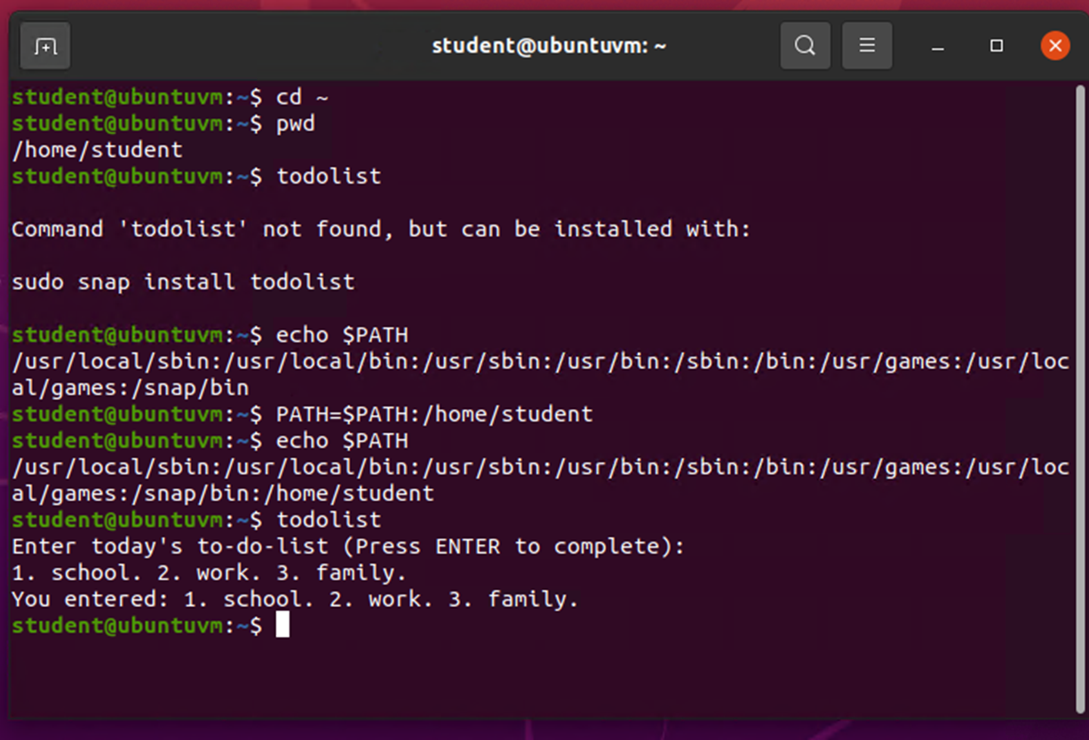
Module 3 Project – Setting path variable
Commands learned and used in Objective 3:
  I used “echo $PATH” to display the current directories within $PATH.
  I then used “PATH=$PATH” to add my home directory to $PATH and checked it using the “echo” command
  I was then able to execute “todolist” by typing it in the control line (pictured Right).

Slide 10
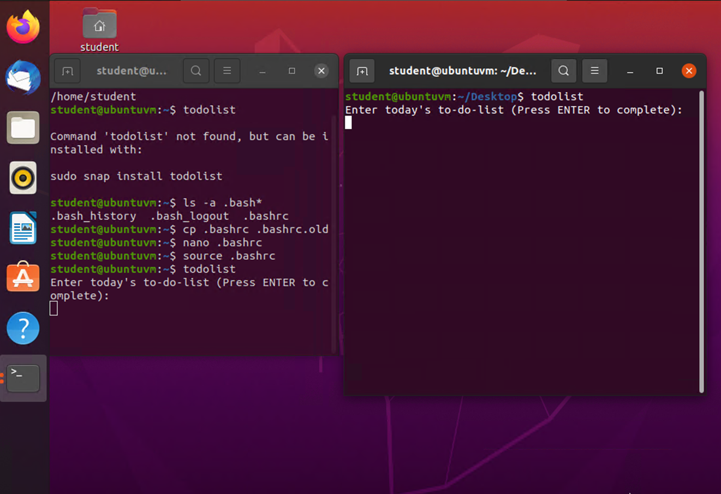
Module 3 Project – Making the path variable permanant
Commands learned and used in Objective 4:
  I made a copy of the .bashrc file using “cp .bashrc .bashrc.old
  I edited the .bashrc file using “nano” and added the line “export PATH=$PATH:/home/student”.
  I then used “source” to activate the change.
  I verified the change by opening a new terminal window and running the script from the command line (pictured Left).

Slide 11
Module 4 Project
In week 4 of this course, I learned about User and Group Management within Linux.
The Project was completed using a Microsoft Azure cloud-based Ubuntu VM
The project focused on 4 objectives:
  Adding Users and Groups using the command line
  Testing the User and Group settings
  Adding a new User through the GUI
  Removing Users and Groups

Slide 12
Module 4 Project – Adding users and groups from the cli
Commands learned and used in Objective 1:
  I added a user named mary using “sudo useradd –m –s /bin/bash mary”.
  I then created a temporary password for mary by using “sudo passwd mary”.
  Next, I added a group called students by using “sudo groupadd students”.
  I then used “sudo usermod –a –G students mary” to add mary to the students group.
  Lastly, I verified the changes by using “sudo tail -3 /etc/shadow” to confirm the new account for mary and “sudo tail -3 /etc/group” to verify mary was added to the students group.

Slide 13
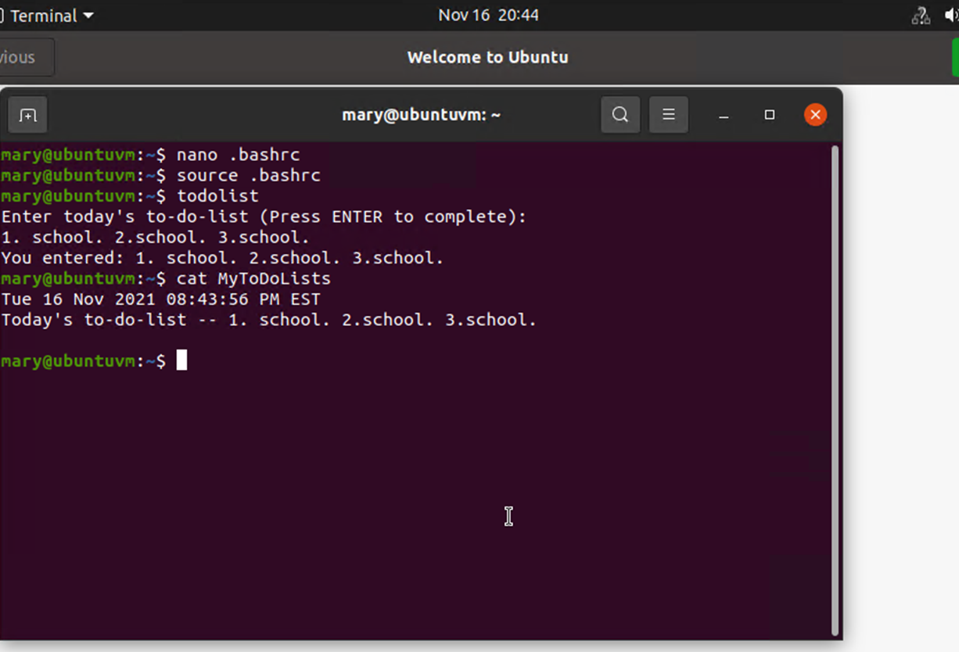
Module 4 Project – Testing the user and group settings
Commands learned and used in Objective 2:
  I used “sudo chgrp students todolist” to change the group ownership of the todolist.
  I verified the change using “ls –l”.
  I then used “sudo chmod 750 todolist” to give read and execute permissions to the group.
  Next, I logged in as mary, edited the .bashrc file with “nano”, and added the home directory to $PATH.
  I used “source” to activate the change and then executed the todolist file from the command line (pictured Right).

Slide 14
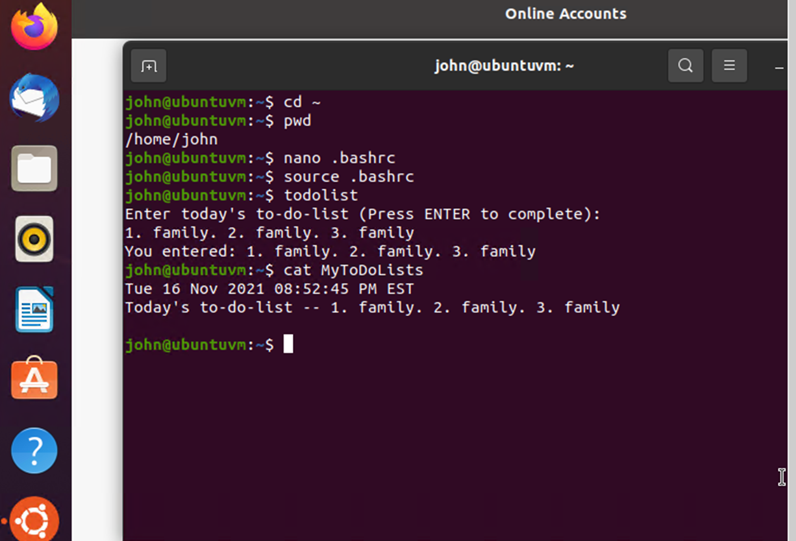
Module 4 Project – Adding a new user with the gui
Commands learned and used in Objective 3:
  From the GUI I selected the “Users and Groups” icon.
  I tapped the Add button.
  I created user “john” and entered a temporary password.
  I highlighted john in the user list and tapped the Manage Groups button.
  I highlighted students and tapped the Properties button.
  I selected john and clicked the ok button.
  I logged out and logged back in as john.
  I then altered the .bashrc file like I did with mary and executed the todolist file from john’s command line (pictured right).

Slide 15
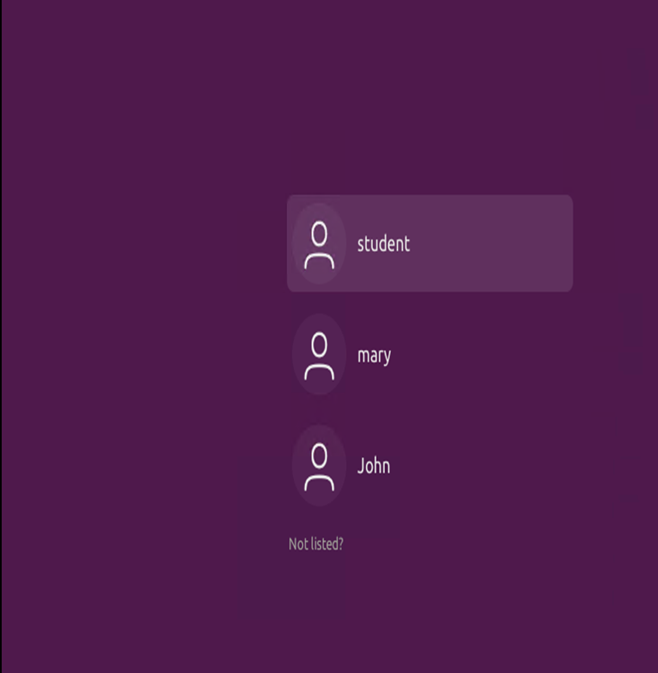
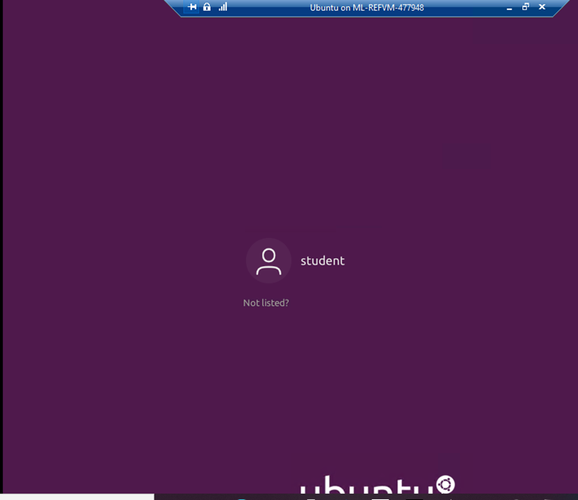
Module 4 Project – removing users and groups
Commands learned and used in Objective 4:
  I used “sudo userdel –r mary” and sudo userdel -r john” to delete both users.
  I used “sudo groupdel students” to delete the group.
  I entered “sudo chgrp student todolist” to change ownership back to my primary group.
  I logged out and verified the users were removed.
  Before and after pictures are displayed on the Left.

Slide 16
Module 5 Project
In week 5 of this course, I learned about Network Configuration within Linux.
The Project was completed using a Microsoft Azure cloud-based Ubuntu VM as well as a DHCP Server VM
The project focused on 3 objectives:
  Discovering Host IP Configurations
  Managing Network Interfaces
  Using Network Utilities

Slide 17
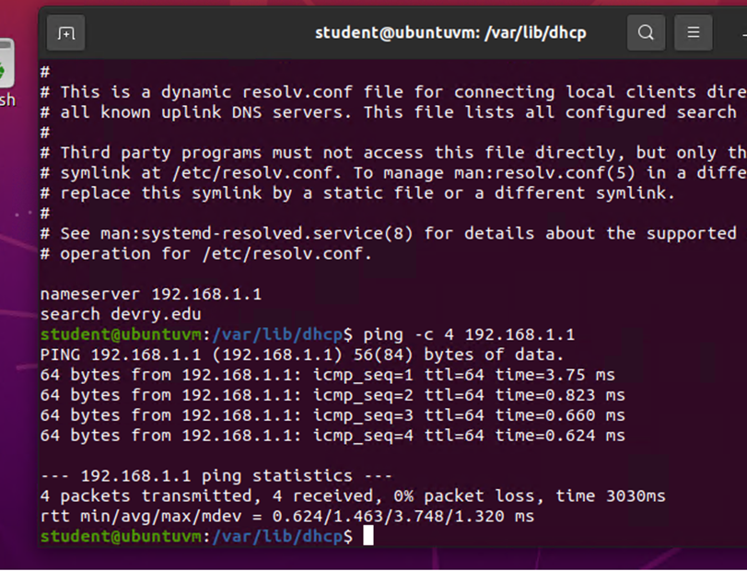
Module 5 Project – Discovering Host ip configurations
Commands learned and used in Objective 1:
  First, I used “ip addr” to display IP addresses assigned to all network interfaces.
  I used “ip route” to identify the default gateway IP address.
  Then I entered “cd /var/lib/dhcp” then used the “ls” command to list the lease files.
  Next, I ran “cat dhclient.leases” to find the DHCP server IP address.
  I then ran “cat /run/system/resolve/resolv.conf” to find the DNS server IP address.
  Lastly, I used “ping –c 4 192.168.1.1” to verify the connection and ping the DNS 4 times (pictured Right).

Slide 18
Module 5 Project – Managing network interfaces
Commands learned and used in Objective 2:
  First, I used the “ip link” command to display all network interfaces.
  I used “sudo ip link set eth0 down” to disable the eth0 interface.
  Then I ran “ip addr show eth0” to verify eth0 is Down.
  I then used “sudo ip link set eth0 up” to re-enable eth0 and verified with “ip addr show eth0”.
  Next, I used “sudo dhclient –v –r eth0” to release the current eth0 IP address and used “ip addr show eth0” to verify.
  Lastly, I used “sudo dhclient –v eth0” to negotiate a new IP address and used “ip addr show eth0” to verify.

Slide 19
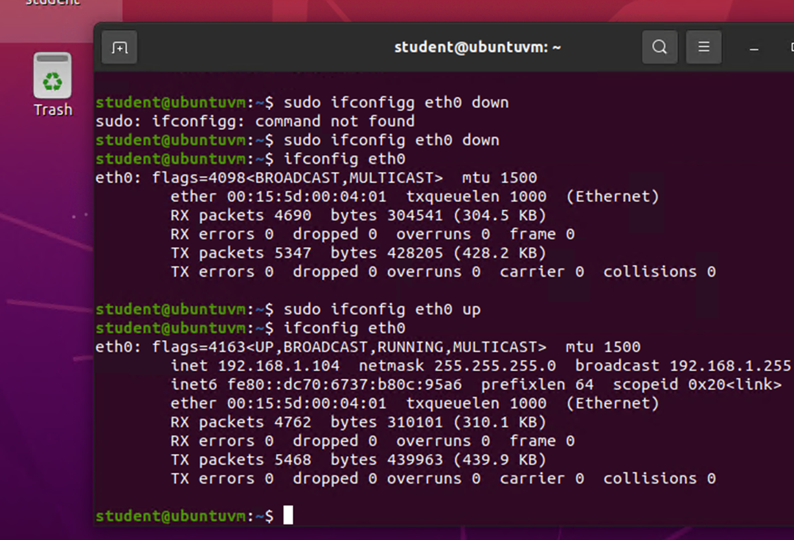
Module 5 Project – Using network utilities
Commands learned and used in Objective 3:
  I used the “ifconfig” command to display IP addresses assigned to all network interfaces.
  I used “sudo ifconfig eth0 down” to disable eth0 and “ifconfig eth0” to verify there was no longer an IP address.
  I then used “sudo ifconfig eth0 up” to enable eth0 and “ifconfig eth0” to verify it now has an IP address (pictured Right).

Slide 20
Module 6 Project
In week 6 of this course, I learned about System Performance Monitoring within Linux.
The Project was completed using a Microsoft Azure cloud-based Ubuntu VM as well as a DHCP Server VM
The project focused on 3 objectives:
  Monitoring Linux Processes
  Monitoring User Activities
  Monitoring Network Bandwidth Usage

Slide 21
Module 6 Project – Monitoring linux processes - htop
Commands learned and used in Objective 1 Part 1:
  I launched the htop utility by entering “htop” on the command line.
  I then opened the calculator application on the GUI.
  Within the htop utility I typed /calculator to find the process. I then used the “k” shortcut key and selected 15 SIGTERM to send a termination signal to the calculator application.

Slide 22
Module 6 Project – Monitoring linux processes - gui
Commands learned and used in Objective 1 Part 2:
  I launched the System Manager application from the GUI.
  I went to the drop menu and verified “Show Dependencies” was selected.
  I then launched Firefox from the GUI.
  I monitored the parent and child processes of Firefox with the System Manager.
  I then highlighted the Firefox parent process and clicked on the End Process button to terminate the processes.

Slide 23
Module 6 Project – Monitoring User Activities
Commands learned and used in Objective 2:
  First, I used the “ac” command to display the number of hours of connection time of all users.
  I then used “ac –d” to display the result per day.
  To view the connect time of each user by day I used “ac –dp”.
  Next, I found the last time the htop utility had been ran and by who by typing “lastcomm htop”.
  I then used “sa –m” to view the number of processes and CPU minutes on a per user basis.
  Lastly, I typed “sudo accton off” to turn off accounting.

Slide 24
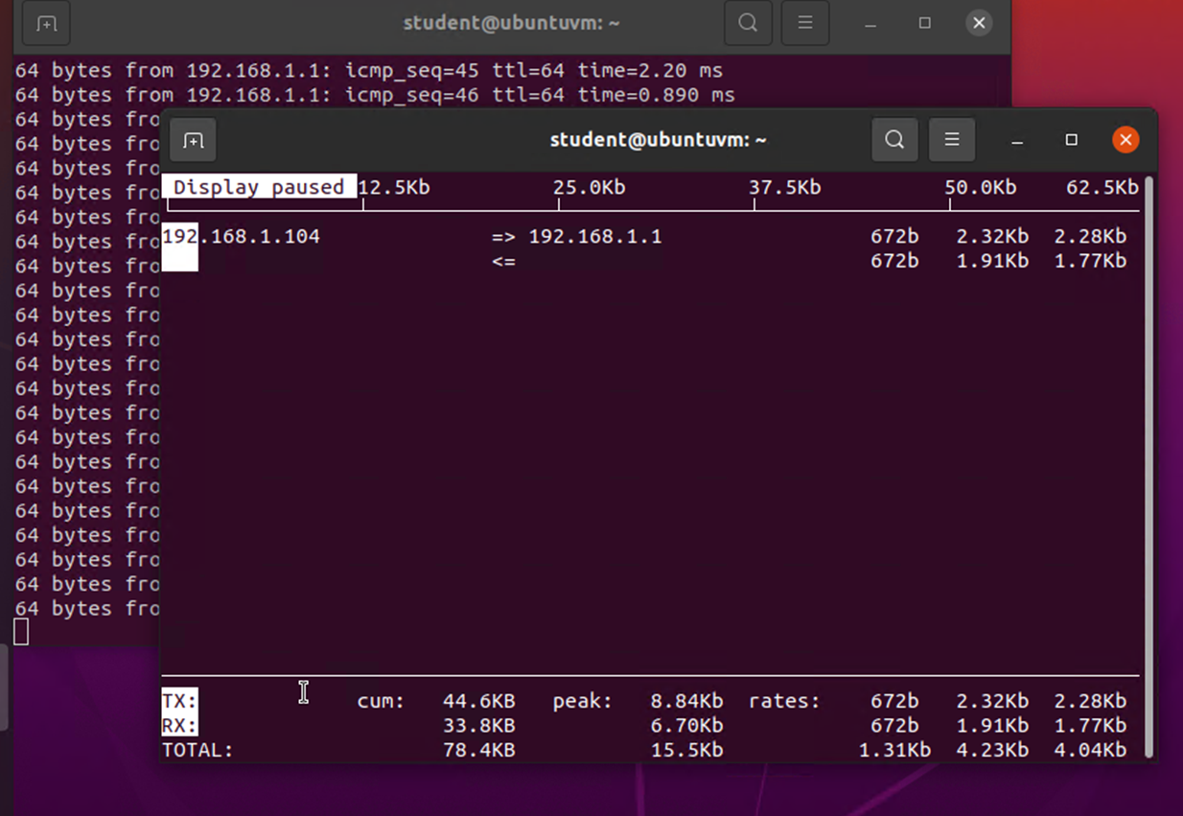
Module 6 Project – Monitoring Network Bandwidth usage
Commands learned and used in Objective 3:
  I entered “sudo iftop” to launch the iftop utility and monitor bandwidth usage.
  I opened another terminal window and began pinging 192.168.1.1.
  In the iftop utility I used the P shortcut key to pause the display (pictured Right).

Slide 25
Weekly Project Challenges
I found this course challenging due to my lack of prior experience with Linux based operating systems. For me, the biggest challenge was learning the syntax and what commands to use. Through this course, as well as the Mindtap labs and ITProTV, I have gained some comfort with the Linux CLI and I feel that I’m capable of overcoming that challenge.
I initially had a lot of very frustrating issues with latency within the Mindtap Labs and Azure Virtual Machines. This was mostly due to me living in a rural area with only DSL as an ISP option. However, after some research, troubleshooting, and tweaking on my PC and network, I was able to minimize the effects of latency to an acceptable level. I’m considering this to be an extra learning experience.

Slide 26
Skills learned
I have learned basic commands to manipulate the Linux CLI.
I have interacted with Virtual Machines and Azure based cloud architecture.
I was able to install an Ubuntu Virtual Machine on my PC using Hyper-V which allows me to get continued experience with the Ubuntu GUI and CLI.

Slide 27

Thank You
CEIS106 Final Project
Shawne Gambrill

