Slide 1

SEC 285
Fundamentals of Information system security
Shawne Gambrill

Slide 2
Introduction and Class Overview
In this class I learned about securing devices and systems.
The work depicted in this presentation was performed using Infosec Lab Environment.
This presentation shows the results of Weekly Projects I completed during this class.

Slide 3
Module 2 Project
In week 2 of this course, I secured a file using Asymmetric Key Encryption.

Slide 4
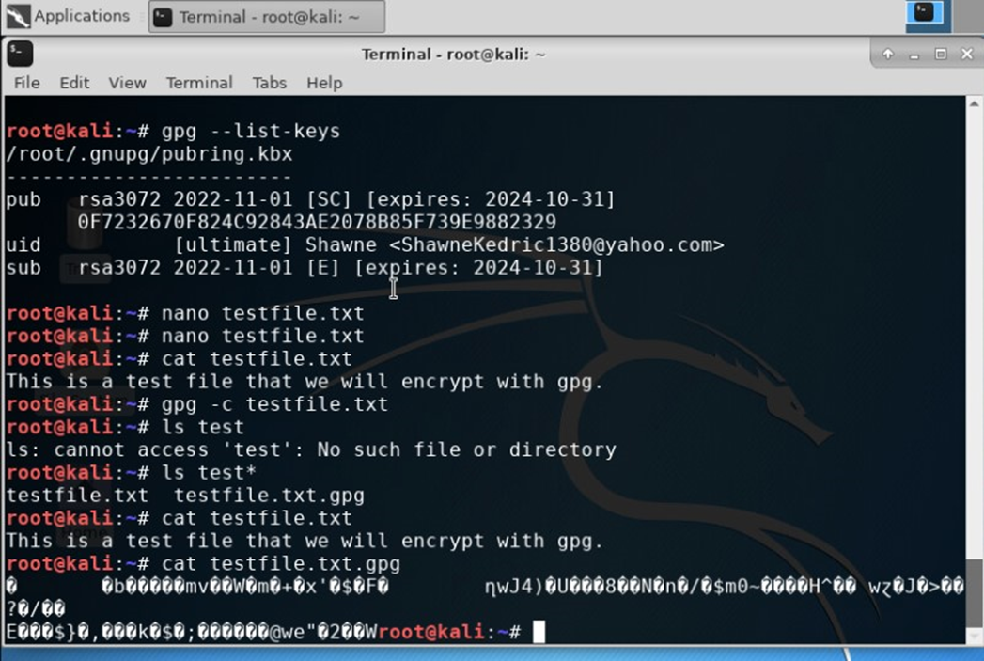
Module 2 Project – Encrypting Files
The screenshot to the left shows both the testfile.txt file as well as the encrypted file testfile.txt.gpg.
Using the cat command, both files are displayed, the unencrypted file is normal, but the encrypted file is un-readable.

Slide 5
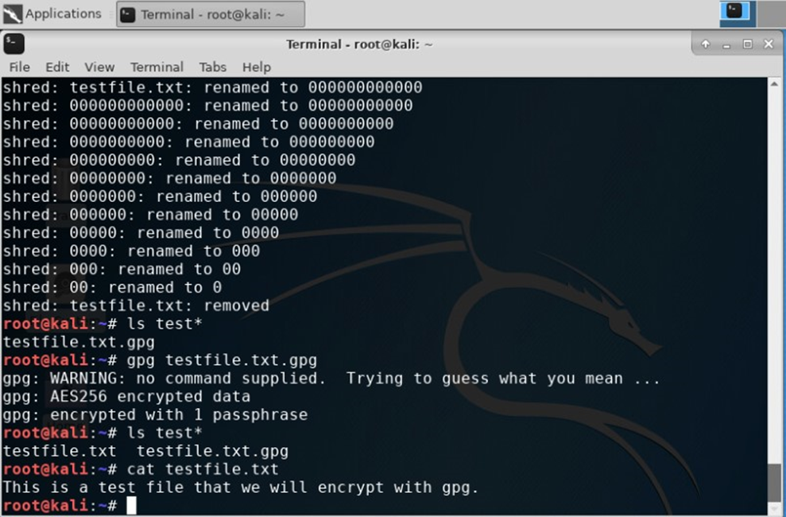
Module 2 Project – Decrypting Files
The second step involved decrypting the file.
The screenshot to the right shows the decryption process and the decrypted file.

Slide 6
Module 3 Project
In week 3 of this course, I executed a Stateful Firewall.

Slide 7
Module 3 Project – sudo iptables –policy input drop
The first part of this project involved using various commands and answering the question: What effect does the sudo iptables –policy INPUT DROP command have on the access to computing resources?
Answer: It drops all the incoming connections to the Linux Server VM and no ports are displayed when nmap is ran from the Kali Terminal.

Slide 8
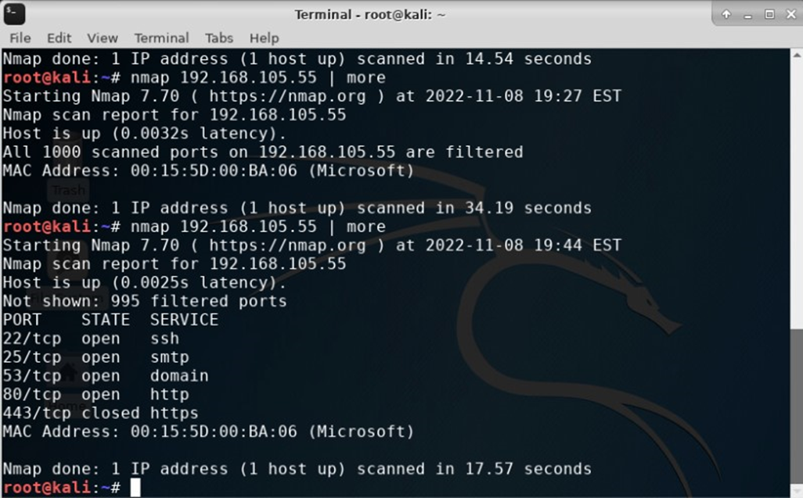
Module 3 Project – nmap scan of established firewall
The screenshot on the left shows the nmap scan of the available ports after establishing the firewall.

Slide 9
Module 4 Project
In week 4 of this course, I created a Bring Your Own Device (BYOD) Policy.

Slide 10
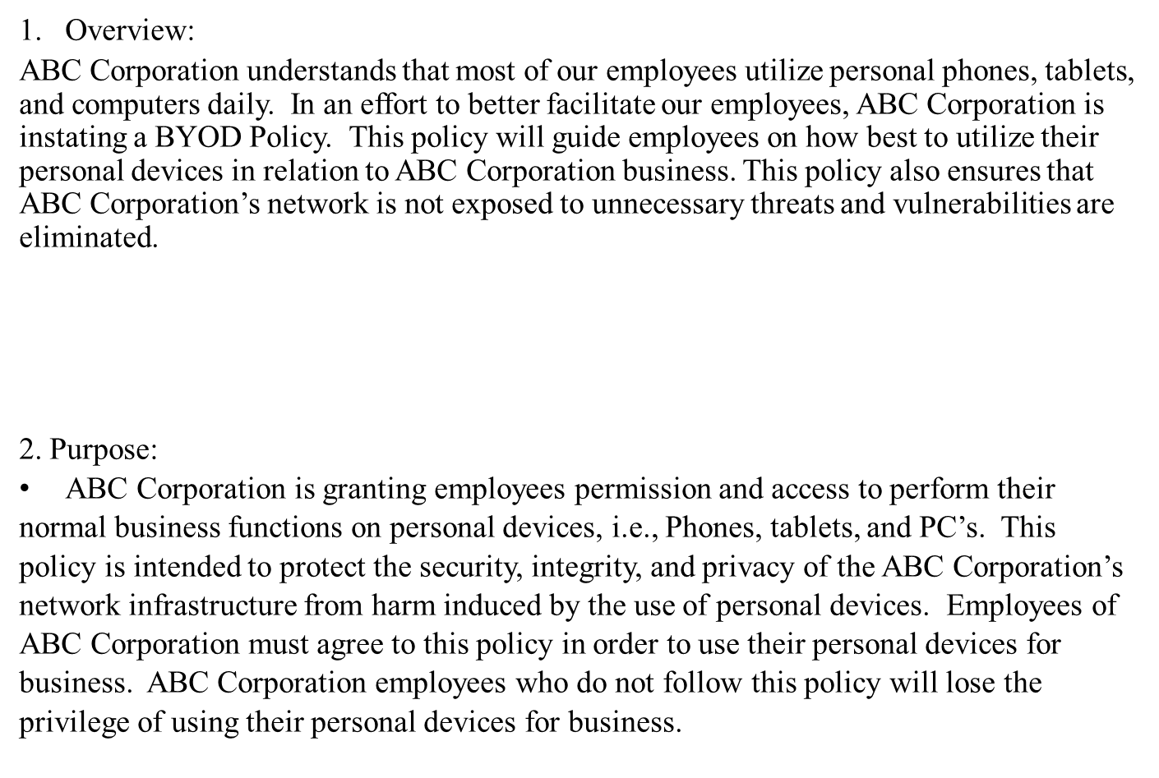
Module 4 Project – Overview and purpose
The first slide covered the Overview and Purpose for the Policy.

Slide 11
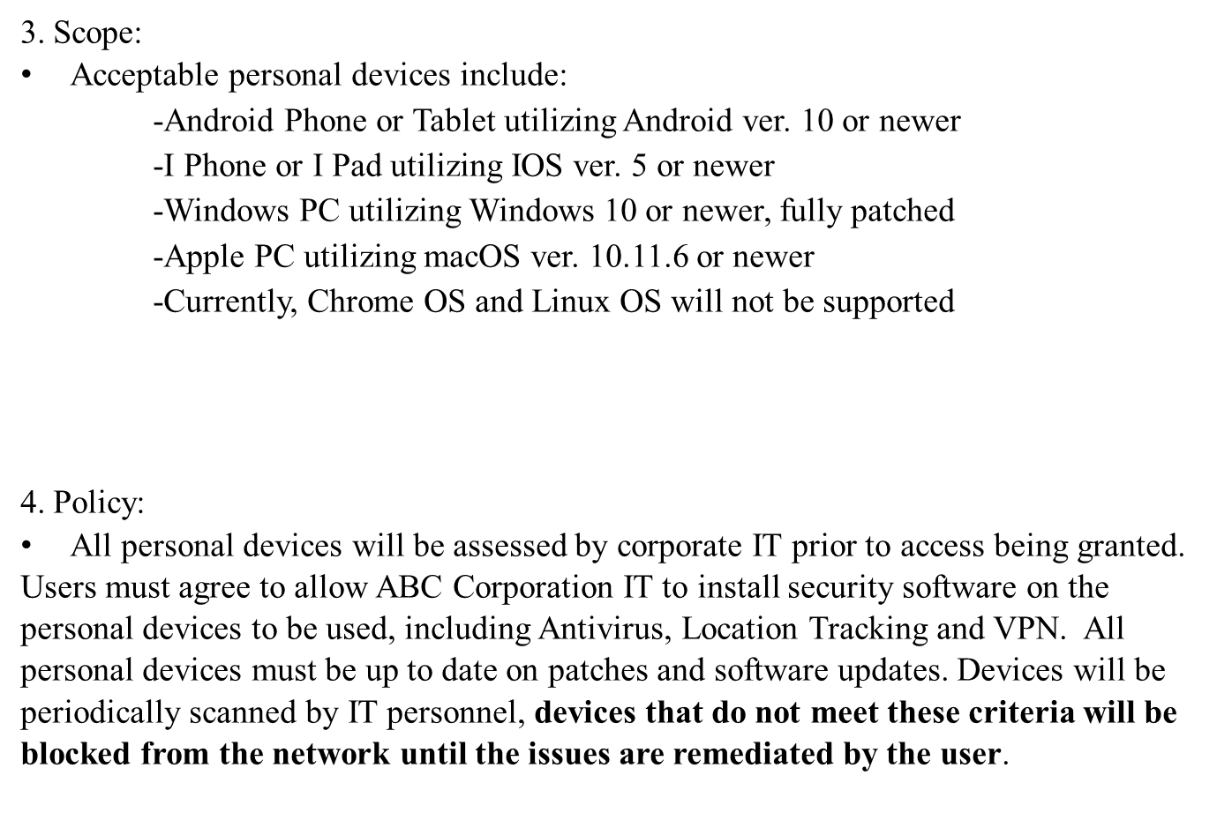
Module 4 Project – Scope and policy
The next slide covered the Scope and Policy.

Slide 12
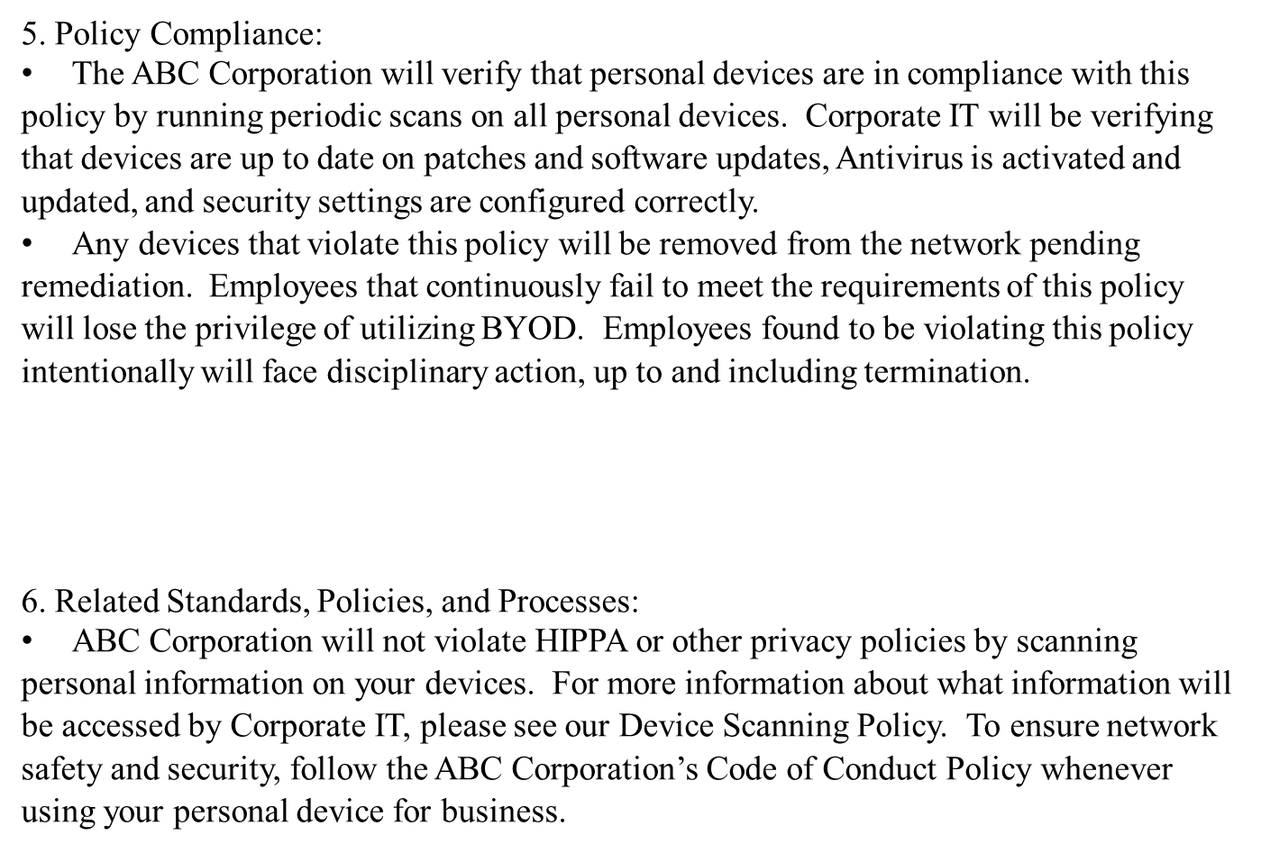
Module 4 Project – Policy compliance and related standards
The next slide covered Policy Compliance and Related Standards, Policies, and Processes.

Slide 13
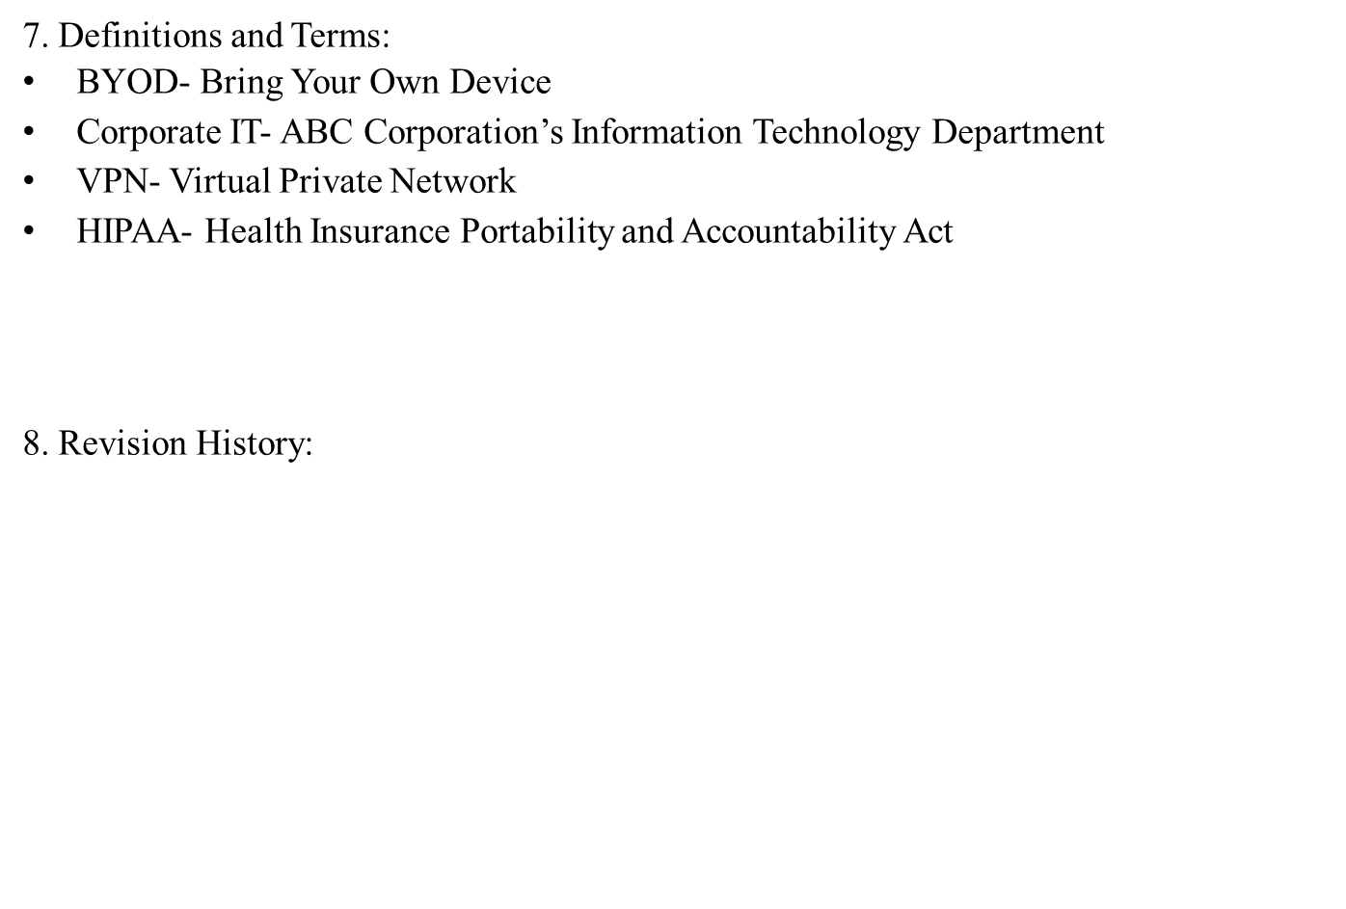
Module 4 Project – definitions and Revisions
The last slide contains Definitions and Terms, as well as the Policy Revision History.

Slide 14
Module 5 Project
In week 5 of this course, I utilized Google Authenticator to create Multifactor Authorization (MFA) for an Ubuntu account.

Slide 15
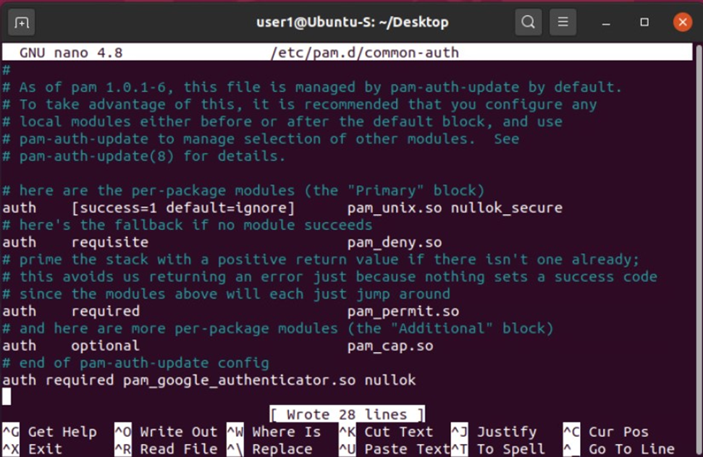
Module 5 Project – adding Google Authenticator to common-auth file
For the first step of this project, I created a new user account on ubuntu.
I then added the line “auth required pam_google _authenticator .so nullok” to the common –auth file.
I then typed “google-authenticator” into the terminal and after answering some questions, received a QR code to connect my phone’s Google Authenticator.

Slide 16
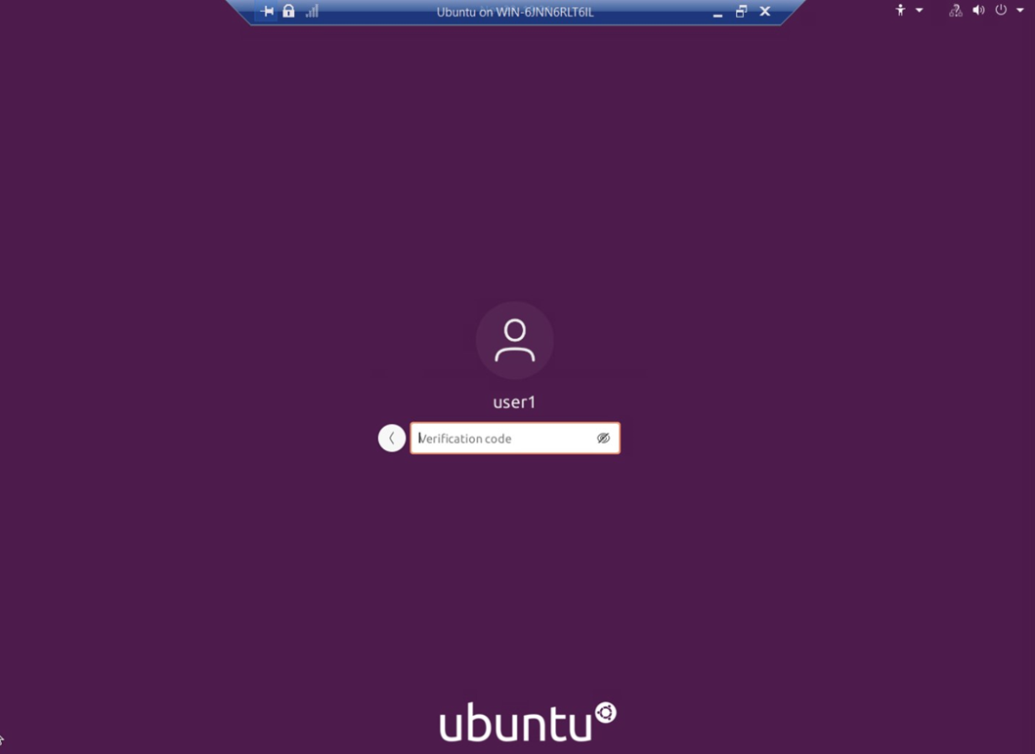
Module 5 Project – Ensuring MFA is required for login
The screenshot to the right shows that the setup was successful, as a Verification code is now required for login.

Slide 17
Module 6 Project
In week 6 of this course, I explored different scanning tools to perform a vulnerability assessment.

Slide 18
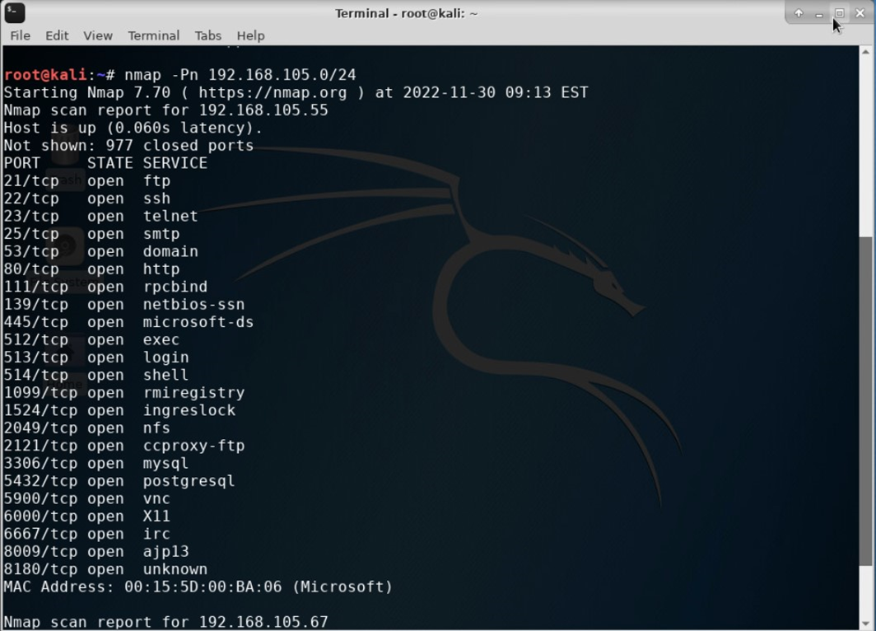
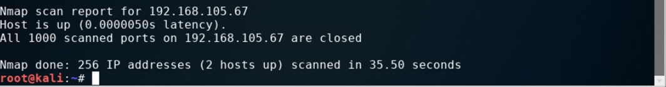
Module 6 Project – nmap
The first scan tool I used was Nmap. This showed all the open ports on both machines on this network.

Slide 19
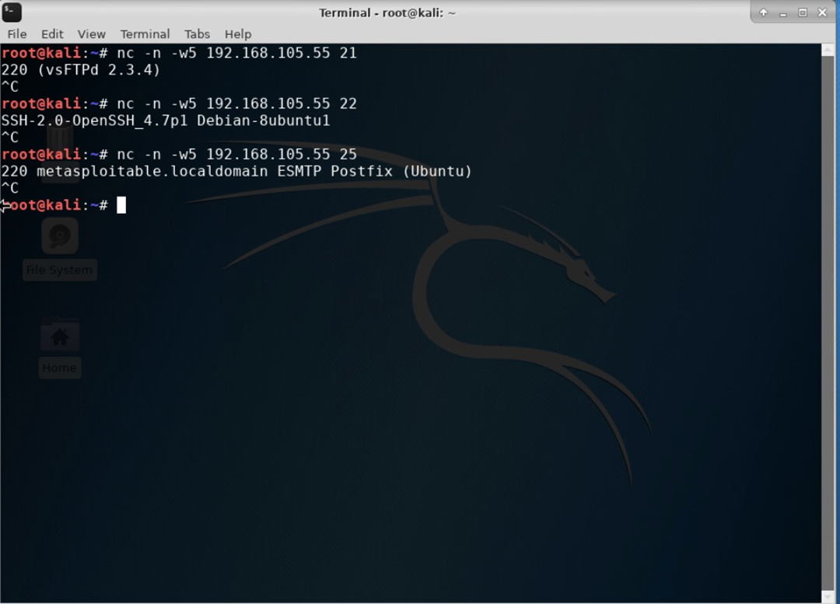
Module 6 Project – netcat
The next tool I used was NetCat. With this tool I was able to see what applications were assigned to each port.

Slide 20
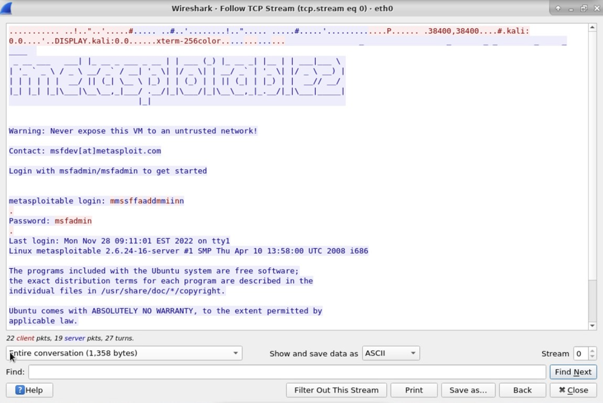
Module 6 Project – wireshark
The next tool was Wireshark. With this tool I was able to track traffic on the network and follow the TCP stream to see the Telnet username and password.

Slide 21
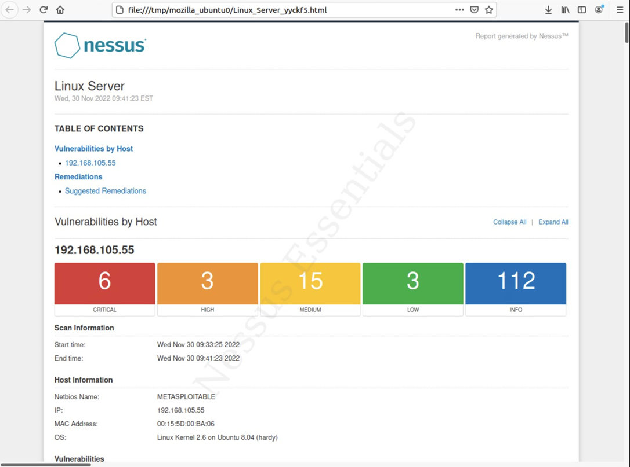
Module 6 Project – nessus
The last tool I used was Nessus. With this tool I was able to see a high-level report of vulnerability issues, as well as a detailed report for each issue.

Slide 22
Weekly Project Challenges
I didn’t really run into any major challenges during this course, as I was familiar with many of the concepts. I did learn a about some tools that I had previously been unaware of.

Slide 23
Skills learned
I learned a great deal about security policies and protocols.
I learned how to increase security on devices as well as networks.
I gained experience with various vulnerability assessment tools.

Slide 24

Thank You
sec285 Final Project
Shawne Gambrill

