Slide 1

CEIS 101 Course Project
Smart Home Automation and Security System
Presented By Shawne Gambrill

Slide 2
Introduction
This is a presentation of my course project for CEIS 101
The project developed an Automation and Security system for a Smart Home.
  Design of a circuit prototype in Tinkercad
  Build the Circuit using hardware from the Tech Core Kit
  Program using Arduino IDE
  The Smart Home system utilizes a door switch to alert to the state of a door, open or closed
  Has a distance sensor to alert of a possible intruder
  Enables lights to turn on automatically when it is dark
  Alerts to possible flooding using a water level sensor
  Monitors temperature and humidity sensors to display weather conditions

Slide 3
Circuit Simulation in Tinkercad

Slide 4
Module 2
For Module 2 I was tasked with building a circuit using Tinkercad.
I then entered code to make the circuit run, creating a blinking red LED.

Slide 5
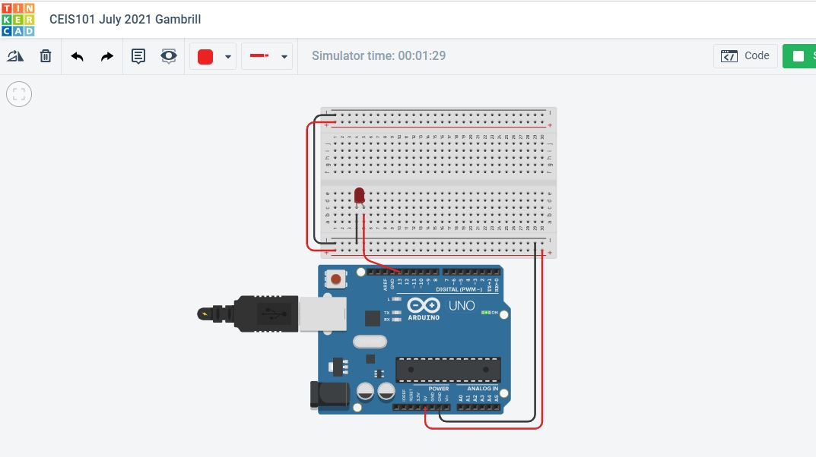
Circuit Screenshot

Slide 6
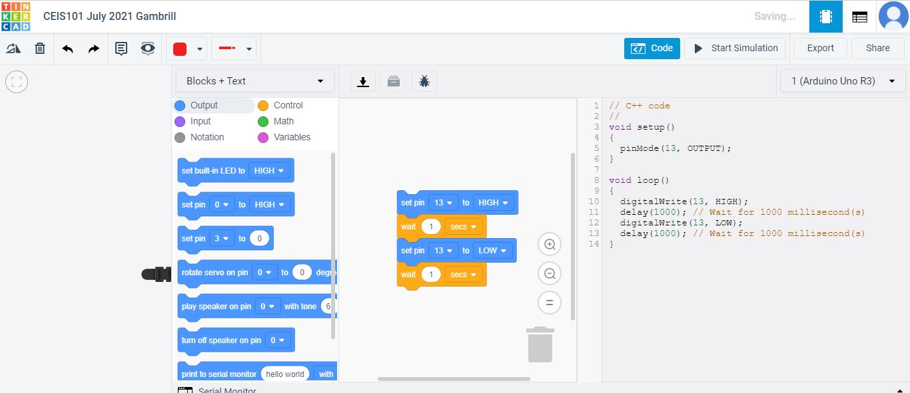
Arduino Code Screenshot

Slide 7
Inventory of parts, Circuit Building, and Displaying Messages

Slide 8
Module 3
For Module 3, I inventoried my Tech Core Kit materials.
I also inventoried the components needed to complete the course project.
I then proceeded to build the circuit from Module 2 using my components and programming my physical Arduino Mega 2560 using Arduino IDE.
Lastly, I used the Serial Monitor tool within Arduino IDE to view the data being created by the programming loop.

Slide 9
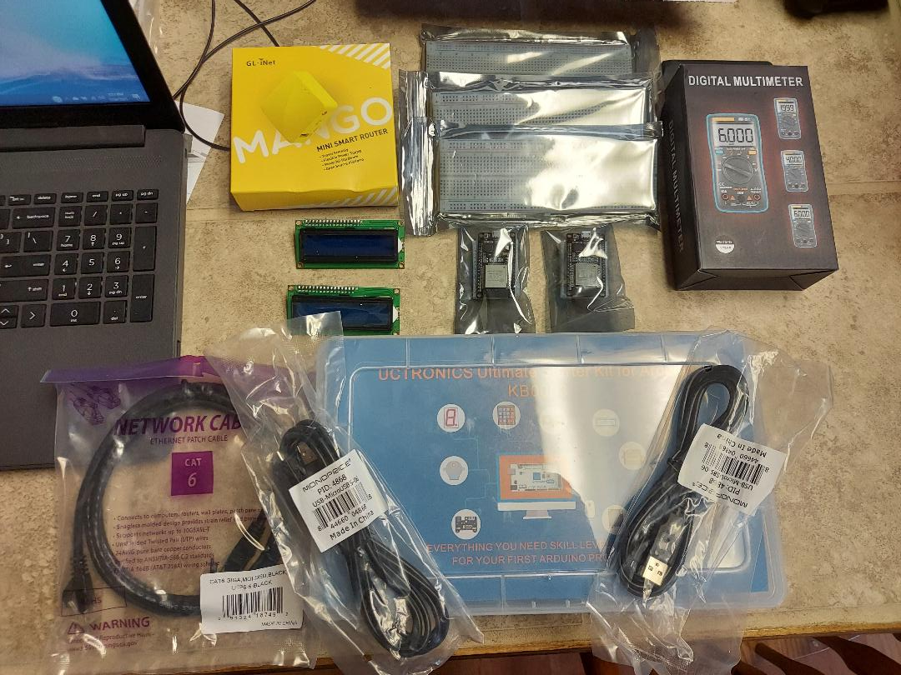
Inventory of IOT Kit
UCTRONICS KIT
ESP32 (2)
LCD MODULES (2)
BREADBOARDS (3)
MINI ROUTER
PATCH CABLE
DIGITAL MULTI METER
USB TO MICRO USB (2)

Slide 10
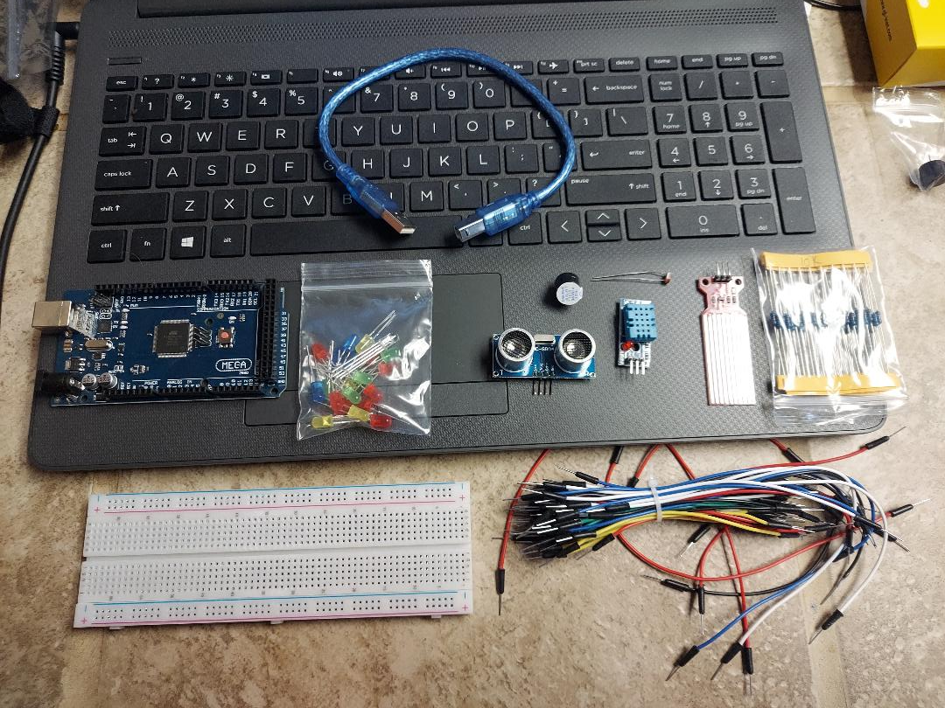
Organization of Project Materials
Arduino Mega 2560
Breadboard
Resistor 10K ohm
LED’s
Ultrasonic Sensor
Passive Buzzer
Photoresistor
Wires
USB Type B Cable

Slide 11
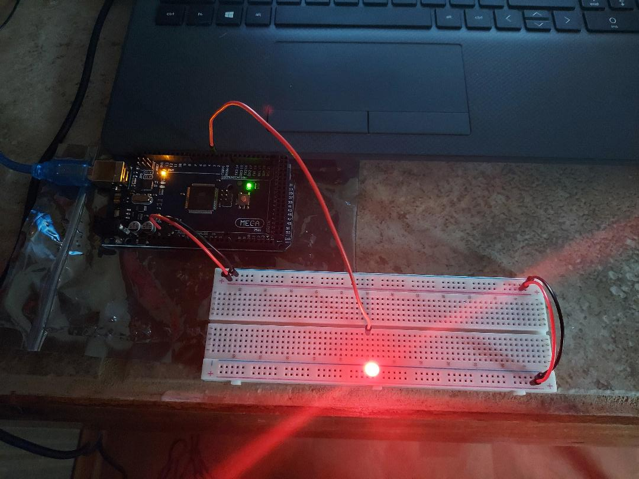
Circuit with Red LED on

Slide 12
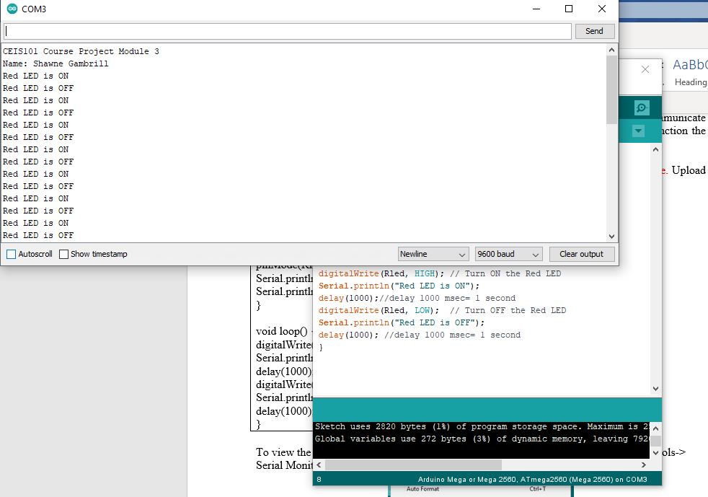
Serial Monitor Screenshot

Slide 13
Adding Door Sensor to smart home system

Slide 14
Module 4
For Module 4 I added a wire that could be removed to simulate an open-door switch.
When the door was simulated as closed, a green LED would light.
When the door was simulated as open, a red and a yellow LED would flash, and a passive buzzer alarm would sound.
The program was updated using the Arduino IDE and I used the Serial Monitor to view data about the device’s condition.

Slide 15
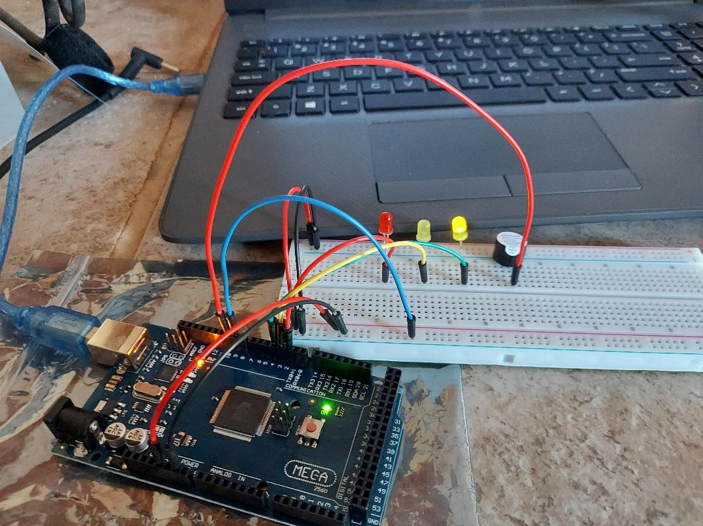
Circuit with Door Closed (Green LED on)

Slide 16
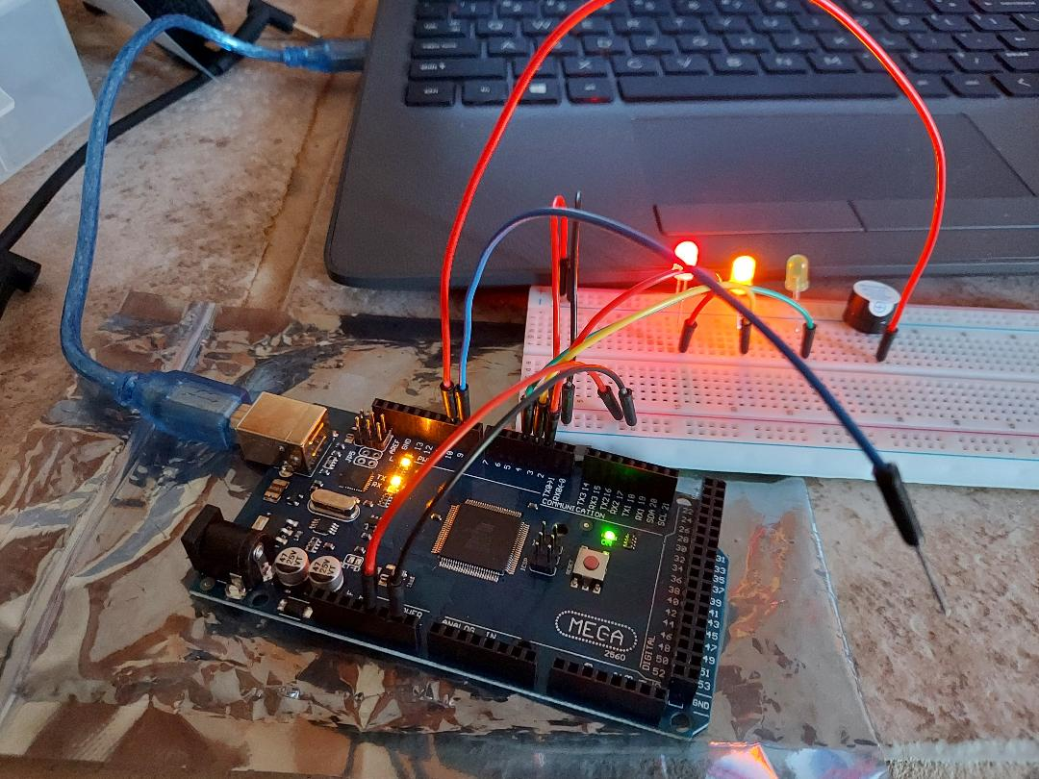
Circuit with Door Open (Green LED off, Alarm on)

Slide 17
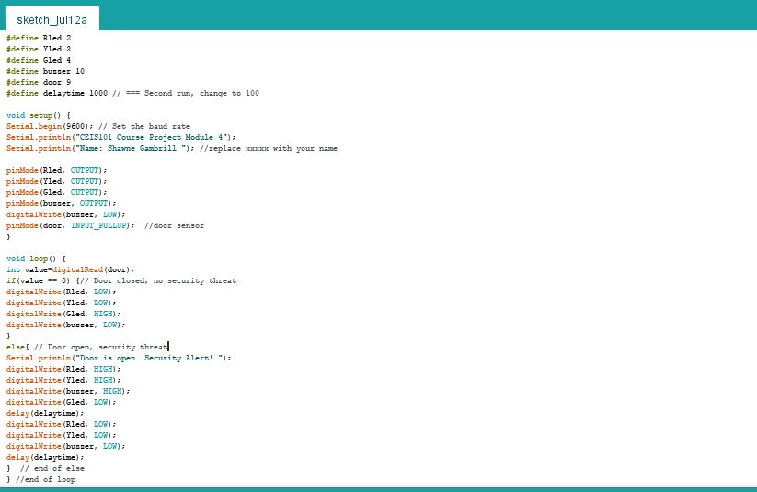
Arduino Programming Screenshot

Slide 18
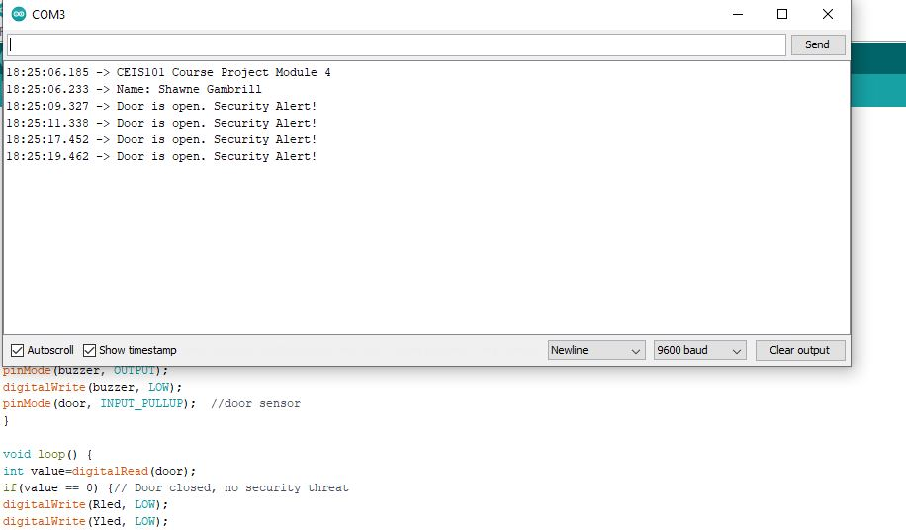
Serial Monitor Screenshot

Slide 19
Adding distance sensor and analyzing data

Slide 20
Module 5
For Module 5, I added a distance sensor which would detect an intruder.
When an object was over 12 inches away from the sensor, a green LED lit and there was no audible alarm.
When an object was within 6-12 inches from the sensor, the yellow LED lit and the passive buzzer would begin alarming.
When an object was within 6 inches, the red LED lit and the passive buzzer would alarm
The passive buzzer alarm was configured to intensify in frequency the closer an object was to the sensor.
I then used the Serial Monitor within the Arduino IDE to monitor the state of device.
Finally, by exporting the data from the Serial Monitor to Excel, I was able to build a graph to show the distance of an object from the sensor over time.

Slide 21
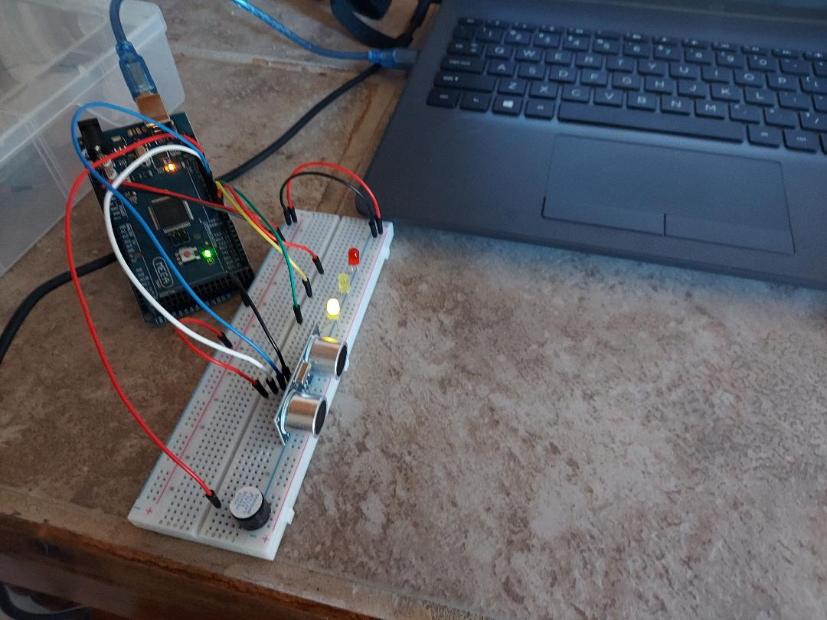
Circuit with Green LED on (Distance over 12 inches)

Slide 22
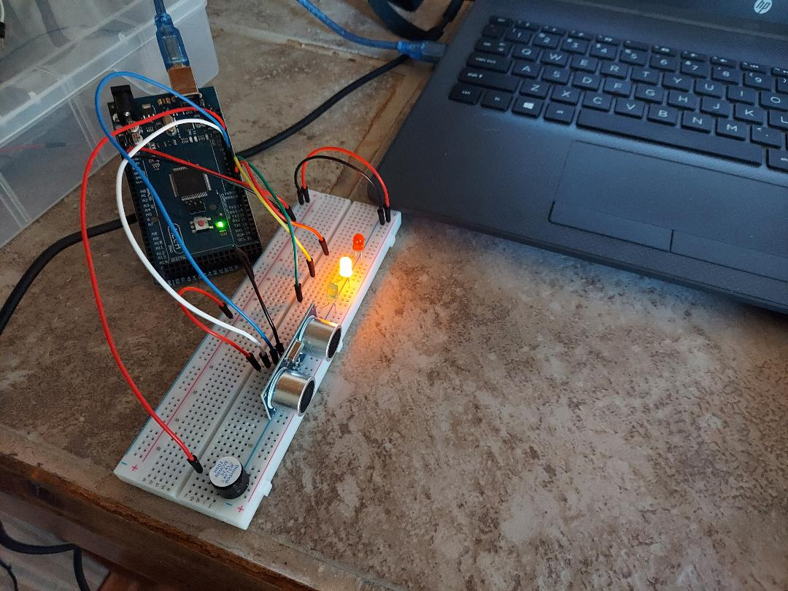
Circuit with Yellow LED on (Distance within 6-12 inches)

Slide 23
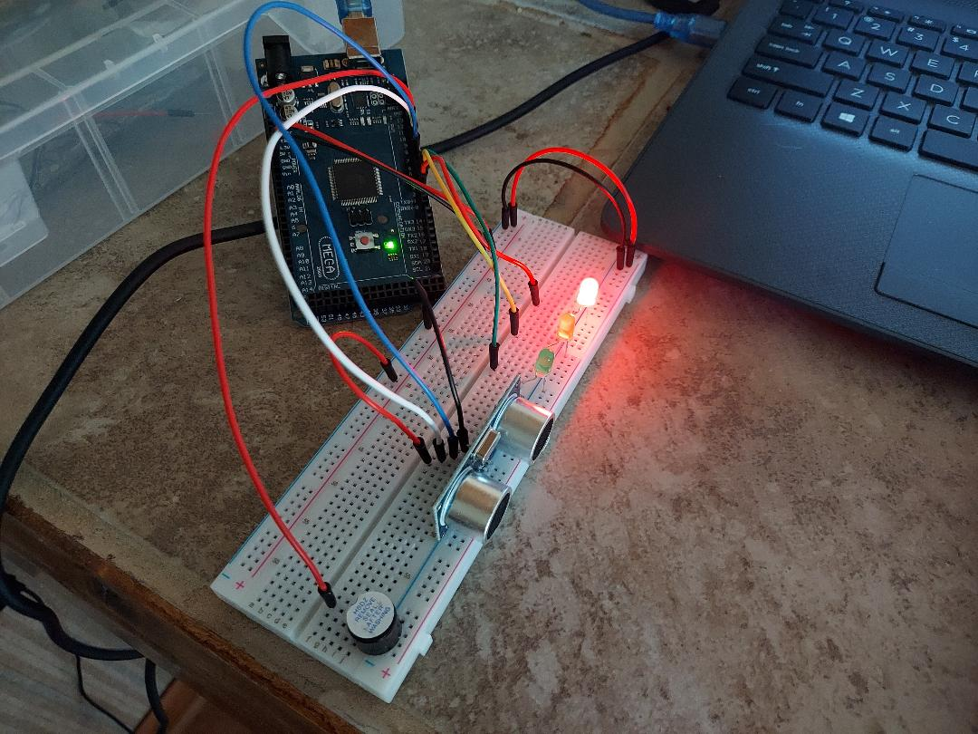
Circuit with Red LED on (Distance less than 6 inches)

Slide 24
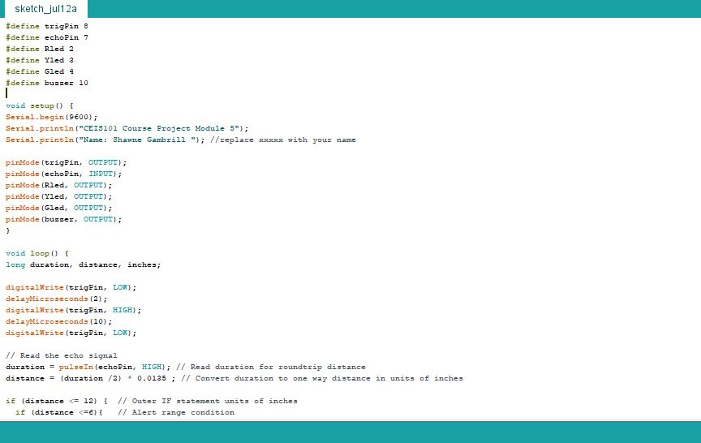
Arduino Code Screenshot

Slide 25
Plot of Data

Slide 26
Adding automatic led to home security system

Slide 27
Module 6
For Module 6, I added a photocell resistor to the circuit.
The program was updated using Arduino IDE.
I then used the Serial Plotter to see what I needed to set the value at to make my LED perform correctly.
When the photocell resistor sensed light above that set value, the blue LED was off.
When the photocell resistor sensed light below that set value, the blue LED was on.
I then used the Serial Monitor within the Arduino IDE to monitor the state of device.

Slide 28
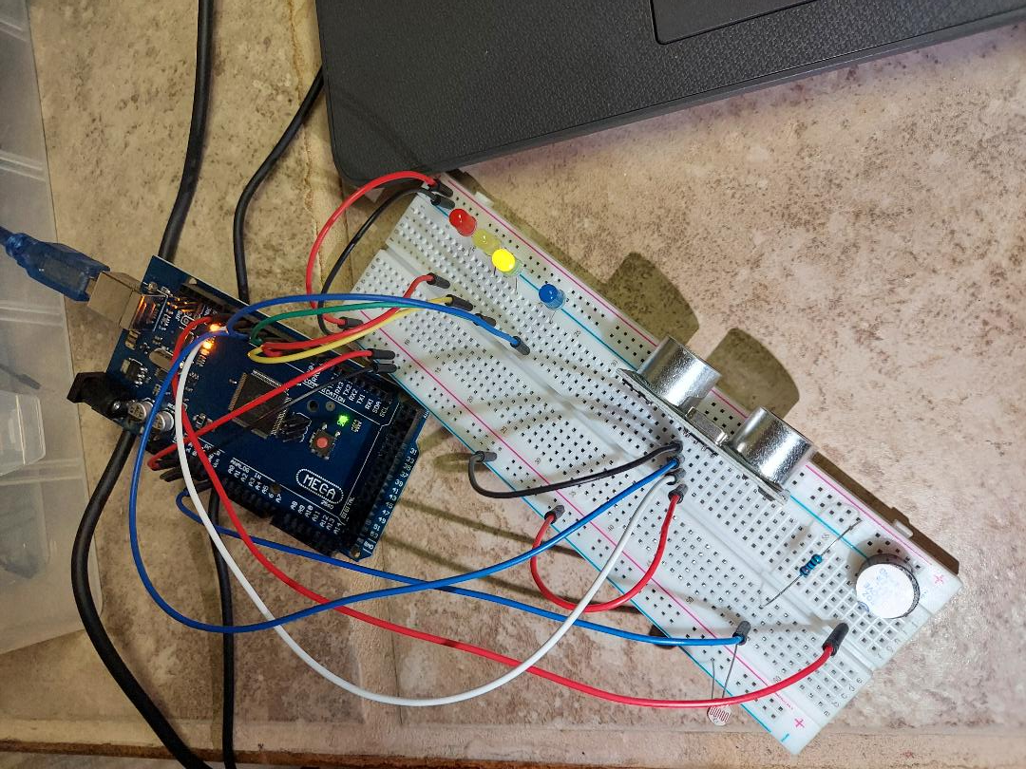
Circuit with Automatic LED Off

Slide 29
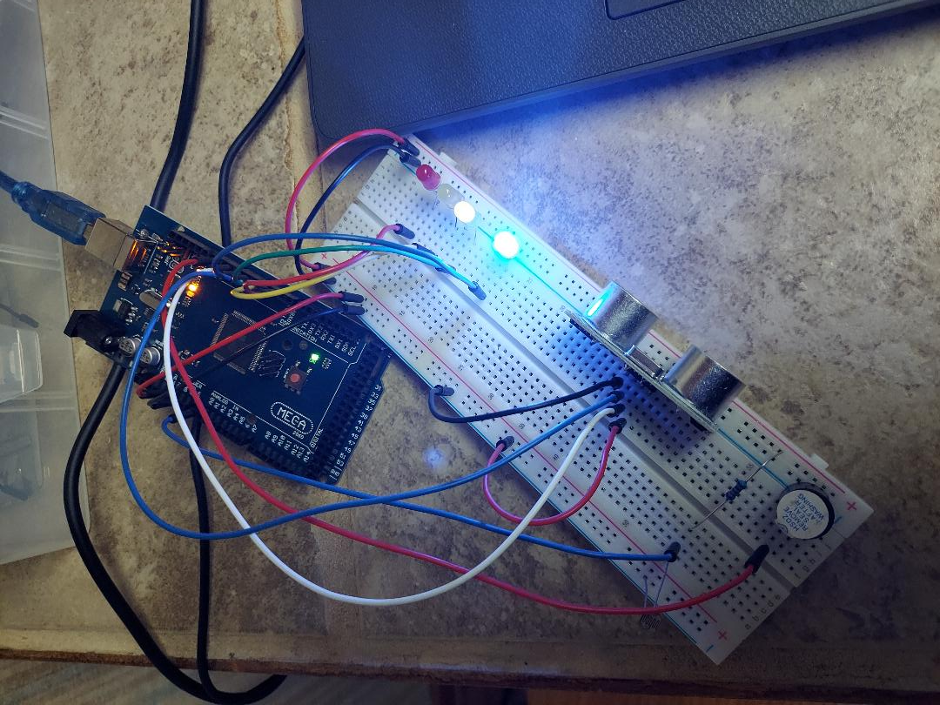
Circuit with Automatic LED on

Slide 30
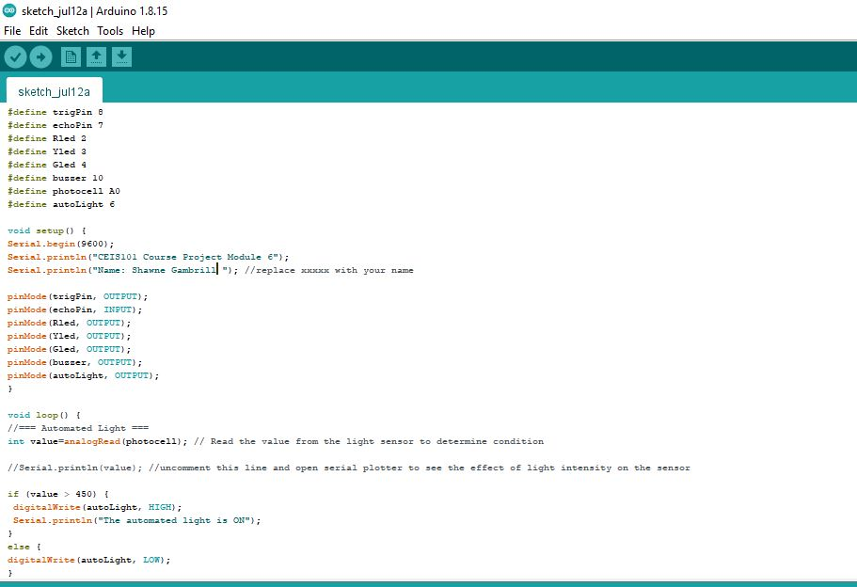
Arduino Code Screenshot

Slide 31
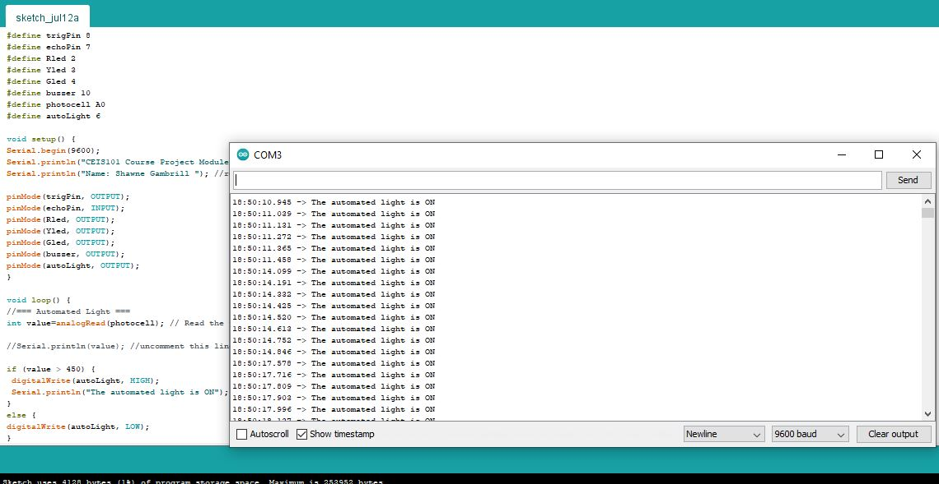
Serial Monitor Screenshot

Slide 32
Adding water level sensor and dht-11 sensor

Slide 33
Challenges 1 and 2
For the Challenge circuits, I added a Water Level Sensor and a DHT-11 sensor.
The program was updated using Arduino IDE.
When the Water Level Sensor detected water, a red LED lit.
The DHT-11 sensor monitored temperature and humidity.
I then used the Serial Monitor within the Arduino IDE to monitor the state of device.

Slide 34
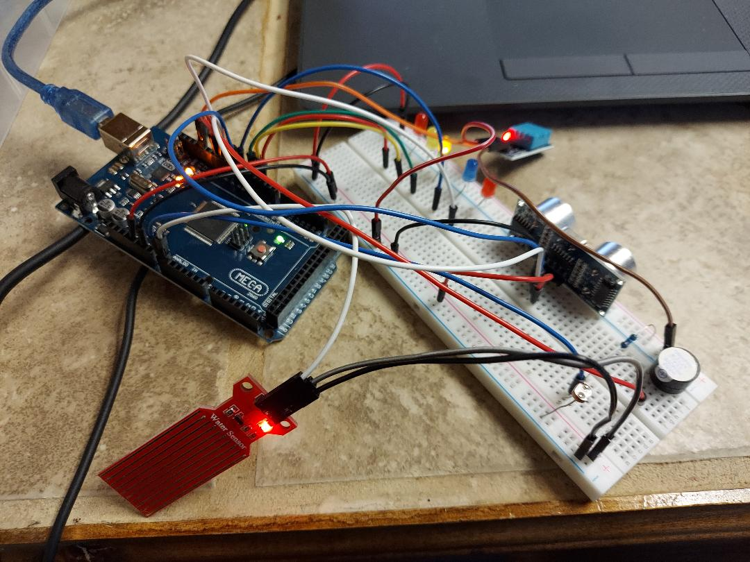
Challenge Circuit

Slide 35
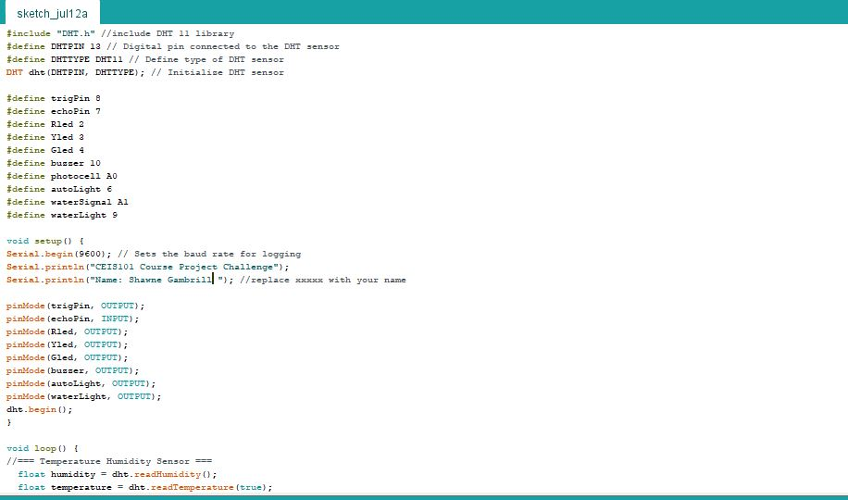
Arduino Code Screenshot

Slide 36
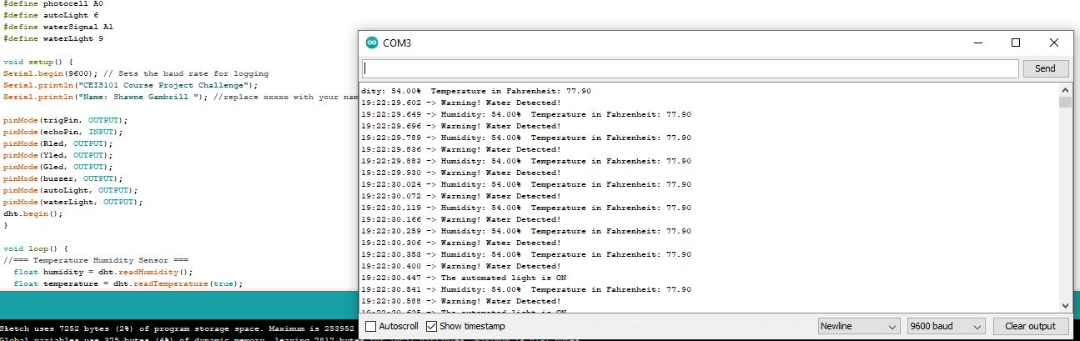
Serial Monitor Screenshot

Slide 37
Closing Comments

Slide 38
Challenges
I had an initial challenge navigating the tools on the Arduino IDE. After some internet research and watching class lectures, I was able to navigate the program easily.
I had an issue when adding the automatic light in Module 6, I fought it for a while trying to figure out why the light was lit when it was not dark. After re-reading the week’s deliverable instructions I found that I could use the serial monitor to figure out what value to use in the programming to make the LED work correctly.

Slide 39
Career Skills Acquired
Hardware/Device Knowledge
Networking and Connectivity ability
Coding and programming
Basic Understanding of IoT
Operating System Functionality
Basic business intelligence and data analytics
Automation
Minimum Security Awareness

Slide 40
Conclusion
I thoroughly enjoyed this course and feel that it has expanded my knowledge on a variety of topics.
This course has given me an insight into what technologies I am most interested in and look forward to pursuing.
Beyond technical knowledge I also learned some very interesting history surrounding technological advancements and achievements.
I look forward to expanding my capabilities to develop/build circuits and program them.

